Slide 1
Reskilling Revolution? Evidence from the Digital Reskilling Lab at HBS
20 JULY 2023
Raffaella Sadun

Slide 2
Why Reskilling?
THE PROBLEM
POSSIBLE SOLUTIONS
NEED FOR EVIDENCE
Digital transformation changes the demand for skills:
Polarization between high and low skill occupations
Up to 32% of jobs may be radically transformed (OECD 2019)
300mn jobs estimated to be affected by Generative AI (Goldman Sachs, 2023)
New jobs created, but also many others at risk of obsolescence
Reskilling—training that helps acquire skills to access a new occupation—may help workers and firms cope with these changes:
1 billion people may need to be reskilled to entirely new roles (WEF, 2021)
Despite public announcements, ongoing investments, reports, etc...
…Evidence on whether and how reskilling works is scant

Slide 3
The Digital Reskilling Lab
The Digital Reskilling Lab aims to develop new rigorous evidence and conceptual frameworks to support organizations that are already, or plan to, invest in impactful reskilling programs.
Our objective is to inform policy at the firm, industry, and government levels and facilitate the adoption of effective practices aimed at strengthening human capital initiatives in the workplace.
2

Slide 4
Activities
Closing the Knowledge and Implementation Gap
Collect evidence on ongoing, large-scale programs
Evaluate the costs and benefits
of reskilling programs
Evaluate the scalability
of reskilling programs
Compare and synthetize approaches across firms
Deep dives
into possible
sources of
frictions

Slide 5
Progress
Knowledge
Implementation
Collect evidence on ongoing, large-scale reskilling programs
Compare and synthetize approaches across firms
Deep dives into possible sources of frictions
Evaluate the costs and benefits of reskilling programs
Evaluate the scalability of reskilling programs
Interviews with approximately 40 CHROs and CLOs of global companies to measures “frontier” of reskilling (rationale, design, implementation)
Surveys across three countries (US, Germany, India) to measure distance from frontier
HBR article on “New reskilling paradigm”
Roundtables with interview participants
- April, October 23
Academic article to report on:
- Clusters of practices
- Correlations with workforce’s outcomes
Study of specific organizational bottleneck emerging from the interviews
Talent Hoarding (managers)
Demand for reskilling (workers)
12 DUAs to explore feasibility of new projects
Of which:
- 2 ongoing evaluations using administrative data
- 2 ongoing partnerships to implement Randomized controls trials (RCTs)
2 partnerships evaluating both pilot and scale-up of a reskilling program

Slide 6
Today’s objectives
PRESENT
LISTEN
RECRUIT
5 paradigms shifts emerging from the interviews
Reskilling needs a different strategic and organizational context to succeed
Early findings from the deep dives
Feedback
Do the findings resonate with you?
Are there other hidden challenges/shifts we should focus on?
Are there other successful reskilling strategies we should study?
Roundtable
Explore a research partnership with the lab
Administrative data
Organizational experiments

Slide 7
Companies we talked to…
ST 17.Apr.23: Data to be finalized
35 companies interviewed
11 industry represented
Company size ranging
from 1,844 to 2,300,000 people
13 countries across 4 continents

Slide 8
5 paradigm shifts identified

Slide 9
OLD PARADIGM
NEW PARADIGM
Reskilling is a CSR or PR initiative to support displaced workers
Reskilling is a key strategic initiative
1
Multinational IT services company identified cybersecurity as a key digital skill for the future, ran reskilling programs to train up to 2000 cybersecurity experts from various starting skill levels
Global company aims to change from a telecommunication firm to a tech firm, can't find developers externally – aims to fill 40% of 7000 open software developer jobs from internal talent
During the peak of the pandemic, US health retailer reskilled workers from different fields (among them laid-off hospitality workers) into their vaccination and testing centers
Notes:
Explanation: Reskilling initiatives are increasingly seen as a way to build competitive advantage, not only a way to take care of displaced workers. Leading players develop talent that is not readily available on the market to fill skills gaps that are instrumental to delivering the corporate strategy.

Slide 10
OLD PARADIGM
OLD PARADIGM
NEW PARADIGM
NEW PARADIGM
Reskilling is an HR responsibility
Reskilling is every leader's and manager's responsibility
2
Global telco makes re- and upskilling an executive level issue: targets are part of the firm's overall strategic scorecard reviewed quarterly by the Executive Committee
US pharmacy chain makes each BU leader responsible for developing their mid and long term reskilling plan as part of their 1-year and 5-year strategy process
European toy manufacturer integrates reskilling into the regular performance management process, making it the responsibility of managers to discuss and plan reskilling needs with each employee
Notes:
Explanation: Many firms still consider reskilling to be the responsibility of HR. As a result, they think of skilling efforts in narrow terms, measuring outcome in number of trainings delivered, cost per learner, and so on. To drive real impact, reskilling targets should be embedded in the annual strategy planning process and in managers' KPIs as well.

Slide 11
OLD PARADIGM
OLD PARADIGM
NEW PARADIGM
NEW PARADIGM
Reskilling is a training initiative
Reskilling is a change management initiative
3
Talent mobility technology connects reskilling with culture. Global consumer goods player uses an intelligent internal talent platform to connect all 100,000 people with job and learning opportunities.
Leading players support mindset change of managers both on the sending and receiving side: e.g. learning-related KPIs in managers' targets, or sensitivity trainings to accept alternatively skilled talent.
Learners undergoing a major life change need support. Tech giant provides coaching and mentoring to new software developers, others organize buddy programs or peer support groups.
Notes:
Explanation: Companies have long considered reskilling just one of many forms of employee training. However, the most successful players approach reskilling as a change-management initiative— one that involves considerable mindset and culture change and requires thorough planning and stakeholder management.

Slide 12
OLD PARADIGM
OLD PARADIGM
NEW PARADIGM
NEW PARADIGM
4
Employees need to be convinced
to reskill
Employees want to reskill – if the offer is good
Several companies strongly involve unions and workers councils in the design of reskilling strategy, or survey learners on their motivation and preferences regarding skilling.
Being very clear on the outcome makes a difference. For example, "train in place" reskilling program models first guarantee the person the new job, then train the person once they are in the job.
Employees need space and time for skilling. As an example, multinational telecommunication company dedicates 4 days per year to employees for pursuing learning opportunities
Notes:
Explanation: Companies used to assume that they would have to work hard to convince employees to reskill, since reskilling amounts to a major life change and requires a lot of effort.
This is not true, Decoding Global Talent: 67% of 200,000 people globally who filled the survey said they are open to reskill to a completely different role.
However, if the value proposition of the program is clear, workers are more willing to reskill than managers might expect .Its not that they dont like learning or reskilling – but very often the value proposition of programs arent clear, they dont know what they get at the end, they dont have mental space or time to skill besides their daily job etc.

Slide 13
OLD PARADIGM
OLD PARADIGM
NEW PARADIGM
NEW PARADIGM
Reskilling is an individual firm problem
Reskilling is best addressed as part of an ecosystem
5
Pooling resources with competitors may help. The Technology in Finance Immersion Program, run by the Institute of Banking and Finance in Singapore, involves 30+ financial services companies to invest in reskilling finance talent for new roles as AI engineers
NGOs can help access hidden talent pools. OneTen is a non-profit organization in the US that partners with corporations and training providers to aid innovative skilling of black workers – already placed 17,000 talent in corporate roles in just a few years' time
New models of partnering with academia are worth exploring. UK Institutes of Technology bring together colleges and major employers in a region to provide practical technical training for workers without tech backgrounds.
Notes:
Explanation: Building reskilling programs from scratch can sound daunting, but it's not necessary. Reskilling takes place in an ecosystem in which many actors have roles to play. Governments can incentivize reskilling through funds, policies, and public programs; industry can team up with academia to develop new skill-building offers, and NGOs provide a bridge to unexplored pools of talent.

Slide 14
Summary
“OLD” PARADIGM
“NEW” PARADIGM
Reskilling is a CSR or PR initiative to support displaced workers
Reskilling is a key strategic initiative
Reskilling is an HR responsibility
Reskilling is every leader’s and manager’s responsibility
Reskilling is a training initiative
Reskilling is a change management initiative
Employees need to be convinced to reskill
Employees want to reskill – if the offer is good
Reskilling is an individual firm problem
Reskilling is best addressed as part of an ecosystem
Notes:
https://europe.autonews.com/automakers/shift-evs-means-huge-reskilling-job-europe-study-says
https://www.acea.auto/message-dg/reskilling-billions-of-euros-to-be-mobilised-for-making-europes-automotive-workforce-future-proof/
https://www.ft.com/content/6e6be236-050a-4bfe-839b-653f6d8cb3ac
https://www.media.volvocars.com/us/en-us/media/pressreleases/283450/volvo-cars-officially-opens-volvo-car-university-campus-in-south-Carolina
GM: https://www.cnbc.com/2022/10/16/how-one-gm-auto-plants-union-workforce-is-learning-to-make-evs.html

Slide 16
Deep dive 1: Talent Hoarding
RESEARCH QUESTION
APPROACH
RESULTS AND IMPLICATIONS
Most organizations rely on managers to identify talented workers for promotions
But managers have an incentive to hoard talent (Heagele, 2022): when a talented worker leaves their team for a promotion, team performance suffers
Do middle managers affect workers’ participation in training programs?
Detailed personnel records from a large retailer, a fast food, and a car company (100,000 employees overall, 5 years of data, 3m observations)
Estimate manager-specific “value added” (differences in team performance systematically attributable to individuals) for a variety of HR metrics, including participation in training
“Good” managers train more, promote more, and as a result have lower turnover and absenteeism, and higher likelihood of adjusting to technology shocks
Reskilling programs need to:
Develop the right organizational context, including appropriate culture and incentives
Quickly identify and counteract internal resistance
Reward/Leverage congruent behaviour

Slide 17
Deep dive 2: Who wants to be reskilled?
RESEARCH QUESTION
APPROACH
RESULTS AND IMPLICATIONS
Companies face difficulties in motivating workers to take part in upskilling and reskilling programs, even when programs benefit them (Stanton et al, 2022)
What motivates workers to take part in a reskilling program?
Possible friction:
Information
Economic opportunities
Self-identification with new jobs
Survey experiments to measure the demand for reskilling
Communication experiments to measure impact of framing on take up
Same program presented to potential participants in different ways
Self-identification in a new job as (if not more) important than expected wages
Targeted campaigns and motivational assessments are key to ensure high and effective take-up

Slide 18
Next Steps
Analyze results from first reskilling survey
(ongoing)
Continue building a community of research oriented practitioners
Build on existing
research partnerships
&
explore new opportunities
Notes:
Layout option for three images and text
To change the image bring in any image into the slide and place the where the current image is located. Delete the current image afterwards.
To adjust the positioning of the image:
Right click on the image > Crop > Drag image to desired position
To resize the image:
Right click on the image > Crop > Press down Shift > drag one of the round corner points in or out to make your image smaller or bigger > drag image side ways to adjust the positioning if necessary

Slide 19
Thank you
Raffaella Sadun
rsadun@hbs.edu
@raffasadun

Slide 20
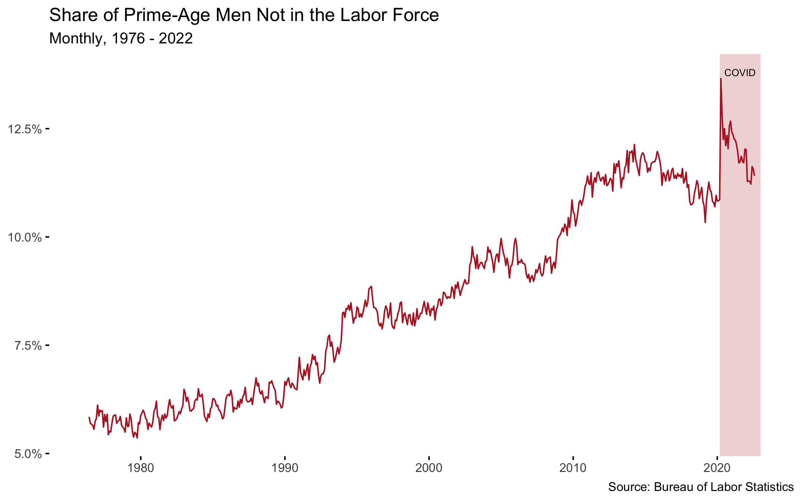
Why Reskilling?

Slide 21
The Digital Data Design Institute at Harvard
Upskill our alums on the changing world
DIGITAL, DATA AND DESIGN
Reinvent how companies will compete and thrive in the 21st century
D³
Leveraged research model for Faculty
Educating the next generation of business leaders
The Institute positions HBS invent the future of global business
Notes:
Need different visual in the middle. That’s the engineering school that’s across the street from HBS. It’s tricky because the building doesn’t exist yet, but maybe an arial view of the HBS campus could work with a pin drop for the location. actioned
Instead of “re-educate” let’s say upskill. actioned

