Slide 1
The role of government and firms in Profit Sharing with employees: Evidence for a discussion
Maria Guadalupe
INSEAD and CEPR
Notes:
“Firm-Worker Profit Sharing Schemes”

Slide 2
Why Profit Sharing
Concern about decline in labor share
and increase in inequality
Fairness and equality of opportunities
Polarization and political instability
Economic consequences (low investment, lobbying and crony capitalism)
Notes:
Inglehart and Norris (2016): In their study titled "Trump, Brexit, and the Rise of Populism: Economic Have-Nots and Cultural Backlash," Inglehart and Norris found that economic inequality, combined with cultural backlash, played a significant role in the rise of populist movements. They argued that those who felt economically left behind were more likely to support populist leaders who tapped into their grievances.
Alesina and Glaeser (2004): Alesina and Glaeser examined the impact of income inequality on political polarization in the United States. They found that higher levels of income inequality were associated with greater polarization along racial and ideological lines. They suggested that economic disparities exacerbated social divisions, leading to political polarization.
Piketty (2014): In his influential book "Capital in the Twenty-First Century," economist Thomas Piketty explored the relationship between wealth inequality and political polarization. He argued that when a small elite controls a large share of wealth, they tend to use their resources to influence the political process, leading to policies that further benefit the wealthy and exacerbate inequality.
Bartels (2008): Bartels conducted research on the relationship between income inequality and political preferences in the United States. He found that higher levels of income inequality were associated with increased support for conservative policies among higher-income individuals, while lower-income individuals showed stronger support for redistributive policies. These differing preferences contributed to political polarization.
Gilens and Page (2014): Gilens and Page analyzed data on policy preferences and outcomes in the United States and concluded that economic elites and organized interest groups have a disproportionate influence on policy decisions, while the preferences of the general public have a minimal impact. This study suggested that economic inequality can lead to political polarization by creating a disconnect between the policy preferences of different socioeconomic groups.
Stiglitz, J. E. (2012). "The price of inequality: How today's divided society endangers our future." In this book, Nobel laureate Joseph Stiglitz examines the economic, social, and political consequences of inequality. He argues that high levels of inequality hinder economic growth, increase social tensions, and erode democratic institutions. T

Slide 3
Mechanisms for Profit Sharing in Firms
Wages
Pay-for-performance:
  Individual (Safelite example: ½ of prod effect)
  Team
Broad based profit-sharing schemes
ESOPs, invested savings or equity shares
-> Should Government incentivize these?

Slide 4
Roadmap
Profit-sharing in Europe
What is the impact of the government incentivized schemes?
  What to expect?
  Evidence for mandated scheme in France (participation)
  Evidence from voluntary adoption schemes in France and internationally
Discussion
Much of this comes from Guadalupe, Landais, Sraer “Que faut-il attendre des mécanismes de partage de la valeur ?” Les notes du conseil d’analyse économique, n° 79, juillet 2023

Slide 5
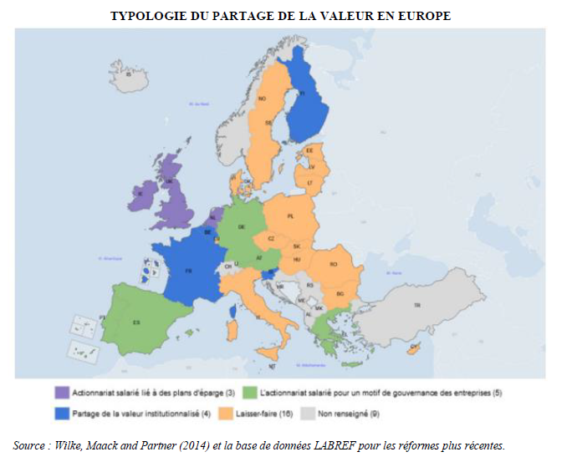
Ownership w savings plans
Employee ownership for governance reasons
Institutionalized profit sharing
Laissez faire
n.a.
Source: Rapport Mission Parlementaire, 2023

Slide 6
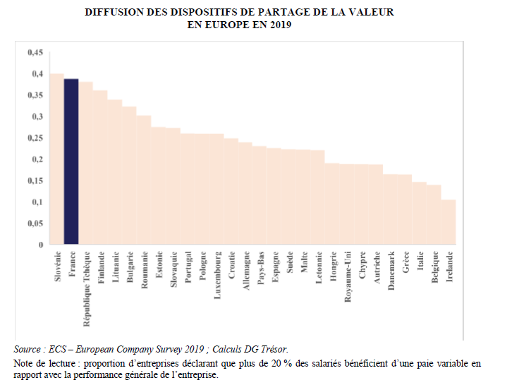
Profit Sharing in Europe
Share of firms reporting that more than 20% of employees have some form of variable pay, related to overall firm performance, 2019
Source: Rapport Mission Parlementaire, 2023

Slide 7
Source: Guadalupe, Landais, Sraer “Que faut-il attendre des mécanismes de partage de la valeur ?” Les notes du conseil d’analyse économique, n° 79, 07/ 2023

Slide 8
Incentivized schemes in France
Mandated profit-sharing scheme: Participation
  Compulsory for firms with 50+ employees
  Mechanical formula based on VA
Several voluntary schemes
  Discretionary formula (objectives- Intéressement) or to all employees below a level of income (PEPA)
Commonalities:
“Team” is the firm: Broad based
Significant tax benefits (no/lower social security costs, does not contribute to profits, and exempt from Income Tax for employee if saved)

Slide 9
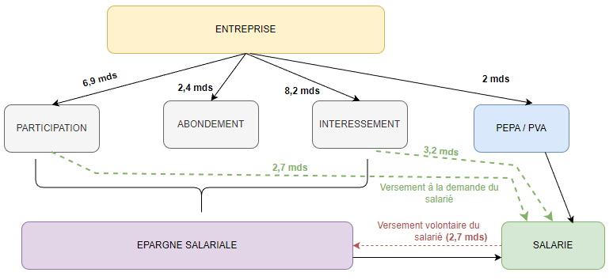
Regulated Profit Sharing Schemes in France
Source : DARES et CAE

Slide 10
Economic Importance
→ 1% of GDP, does not fluctuate much with cycle

Slide 11
Large firms distribute more
→ Inequality comes from size of firms that are more subject to schemes, are more profitable, employ more skilled workers and pay more

Slide 12
Predicted effect of schemes
Incentives to adopt on the side of firms for fiscal reasons
Free rider problem means these are unlikely to operate as strong motivator, no increase performance.
  A relational contract is unlikely to help
Unless… this is part of a package with complementary practices (Milgrom and Roberts): used to foster sense of belonging
  Less likely to emerge in the mandated case (participation).
RISK: firms substitute salary with profit-sharing

Slide 13
Work on Compulsory Scheme in France
Based on David Sraer and coauthors’ work
    Nimier-David E., Sraer D. et Thesmar D. (2023) « Les effets de la participation obligatoire, les enseignement de la réforme de 1990 », CAE, Focus n°100, juillet
Participation:
  Compulsory for firms with 100+ employees until 1990, then threshold was reduced to 50
  Distributed by formula based on firm value added (0.5(VA-0.05*CC)*(Comp/VA)

Slide 14
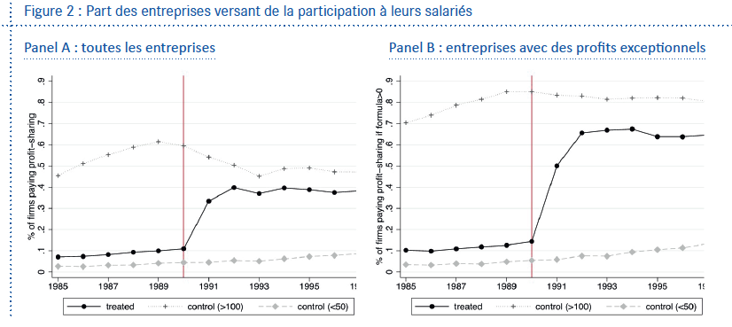
Share of firms that distribute participation

Slide 15
Distribution of Employment around the 1990 reform
Authors find that :
« Excess mass » at threshold around 22%
1% of employment is destruyed around the thresholds because of thershold effects
→ Firms anticipate low adjustment ability
Source: Nimier-David E., Sraer D. et Thesmar D. (2023) « Les effets de la participation obligatoire, les enseignement de la réforme de 1990 », CAE, Focus n°100, juillet

Slide 16
Share of salaries and compensation in VA
Create two control groups :
Treated firms increase:
Share of basesalaries in VA
Total comp in VA
→ Mechanism is successful in redirecting profits towards employees.

Slide 17
Where does the redistribution come from?
Who pays?
Decline in firm recorded profits
Decline in taxes on profits
Other effects:
No effect on productivity or investment
Increase in compensation is for low and mid- qualified workers, full substitution for high skill workers

Slide 18
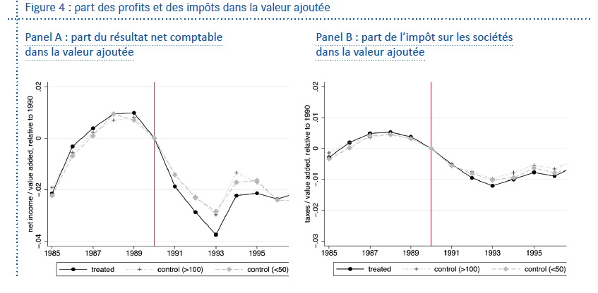
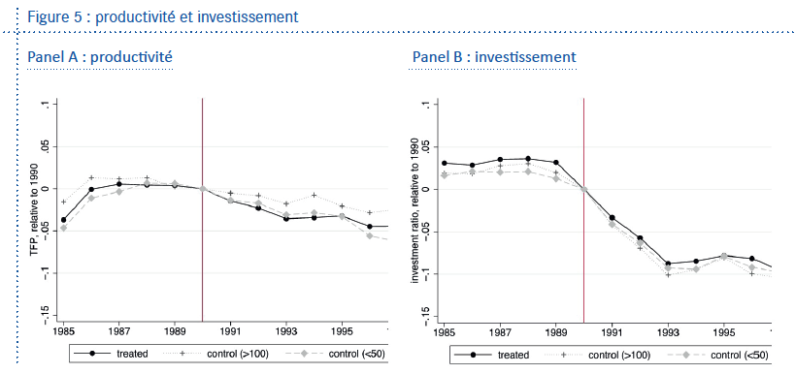
Share of profits and taxes in VA
Productivity and Investment

Slide 19
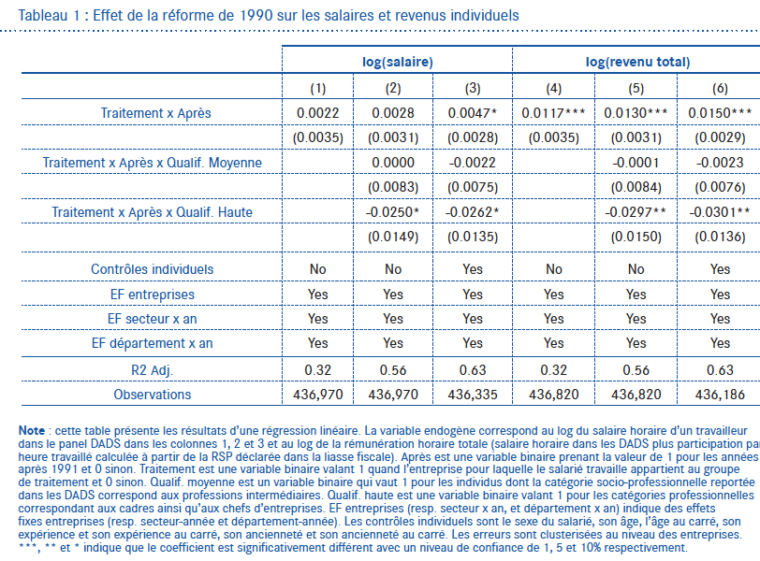

Slide 20
Work on Voluntary Schemes in France
Effect of Intéressement on
Compensation:
  It substitutes wages (Delahaie et Duhautois, 2013)
  Base wage falls; Total compensation is unchanged
On productivity and employment:
  Cahuc et Dormont (1997) : positive on productivity, zero on employment (1988-1989)
  Fakhfakh et Perotin (2000) : positive on productivity, less important if firm is hierarchical(1986-1990)
Selection: firms adopt it following a profit shock; firms with more employee involvement
Notes:
SUR LES REMUNERATIONS Delahaie Duhautois (2013):
Méthodologie: Appariement sur score de propension en double difference; 1997-2007
L’intéressement se substitue en partie aux rémunérations: Modération du salaire de base, mais n’impacte pas de manière significative la rémunération totale.
Etudie Participation aussi: pas d’effets, ni sur salaire ni sur rémuneration totale
“Le fait que l’introduction d’un accord ne s’accompagne pas d’effets significatifs peut être expliqué par des montants de primes distribuées trop faibles pour que l’intéressement se substitue ou complète les salaires”
SUR PRODUCTIVITE ET EMPLOI Cahuc Dormont (1997):
Méthodologie: IV and first differences (mais panel très court); Données 1988-1989;
Effets: positif sur la productivité (2%), zero sur l’emploi
Fakhfakh, Perotin (2000)
Méthodologie: Fonction de production (GLS); 1986-1990; Industry dummies
Effect positif sur la productivité (7%); moins important si entreprise très hierarchique,

Slide 21
International Evidence on Voluntary Profit-Sharing Schemes
Huge selection effect:
  Firms with growing profits, profits shocks adopt it.
  -> Caution interpreting the following results
Positive effects on performance/productivity
  (meta-analyses: Weitzman and Kruse 1990; OECD 1995; Doucouliagos 1995) and profits (Kraft and Ugarković, 2006)
Effect on productivity is greater when there is better communication between firms and trade unions (Biagioli 1995; Fakfhfakh 1997)
Increases the sense of belonging to the firm and makes negotiation with firms easier (Blasi, Freeman, Mackin and Kruse, 2010)
Notes:
Kruse (1993): “probability of profit-sharing adoption increases with rises in profit margins and stock prices, specifically rise in profit margin appears to be most important for prediction of adoption of cash-based plans and rise in stock prices appears to be most important for prediction of adoption of deferred plans”. )
EMPLOI:
Effect on turnover: ambiguous or positive results of the earlier literature but Bellman and Möller (2010) using matching find no effect.

Slide 22
SUMMARY: Effect of (tax incentivized) broad based profit Sharing schemes
Voluntary adoption upon profit shocks: selection in who adopts
  Used to lower taxes? No link to complementary managerial practices
Compulsory adoption scheme is redistributive from firms to workers and increases salaries of low income/low qualification workers
  Binding minimum wage?
Full substitution in voluntary schemes
Modest if any performance effects (at the mean)

Slide 23
DISCUSSION: What would help?
For a company: what is your perception of the usefulness of government mandated schemes
Does the tax incentive distort adoption of better suited pay practices?
What could the government do to promote profit sharing and redistribution? What schemes would help?

Slide 24
Additional Slides

Slide 26
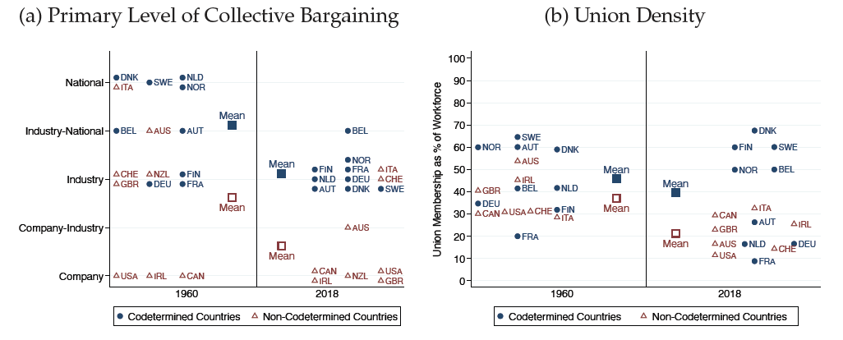
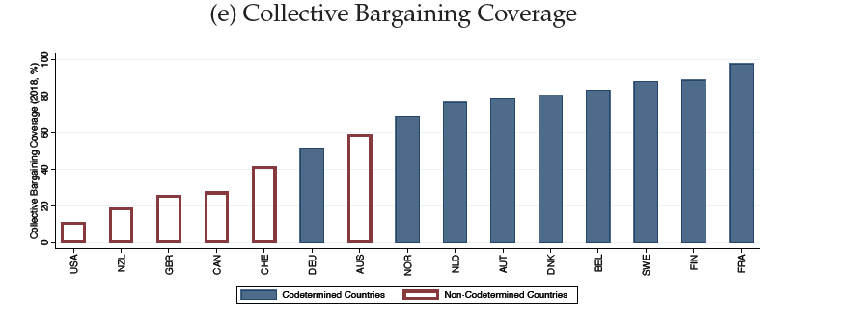
Les autres mécanismes
Syndicats et pouvoir de négociation collective
Source: Jäger et al. (2022)

Slide 27
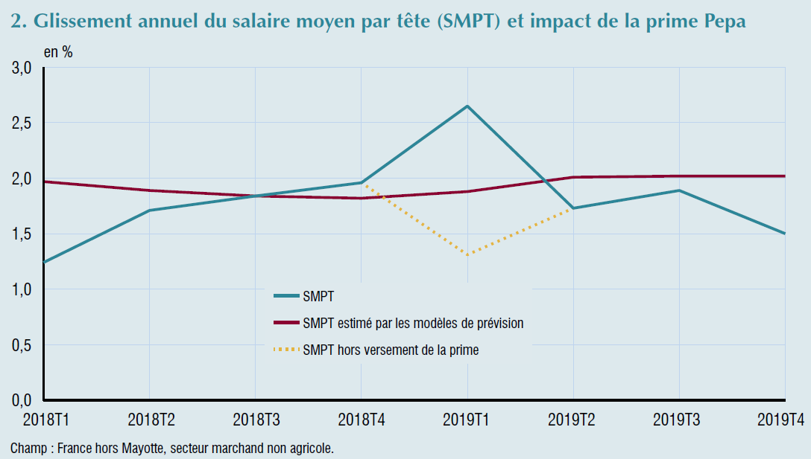
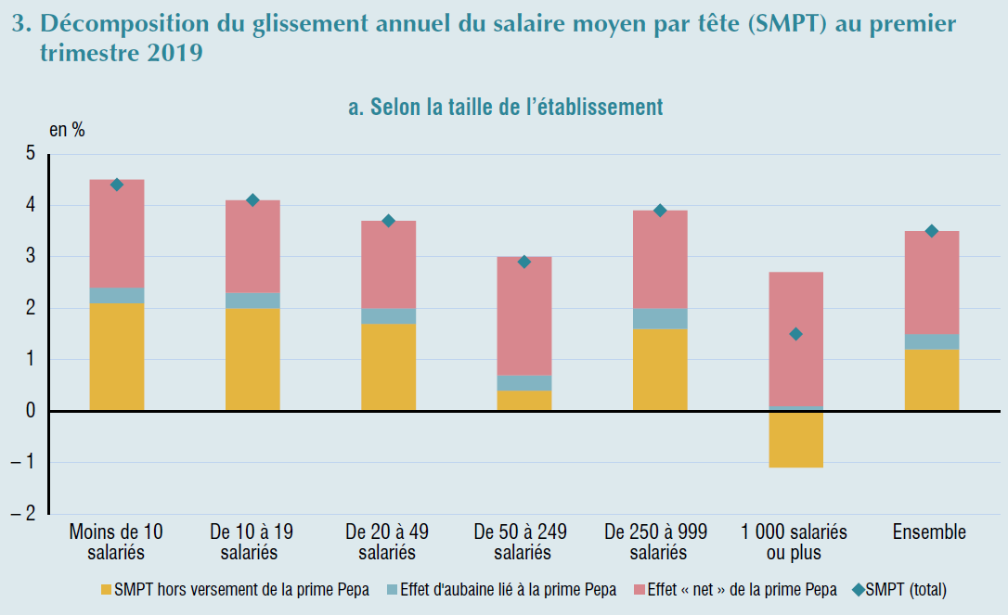
Effets de la Prime exceptionelle de Pouvoir d’Achat
L’INSEE estime que les effets de substitution de la PEPA aux salaires seraient de l’ordre de 15 à 40%, selon qu’on retient une approche micro-économique (15 %) ou macro-économique (40 %).

Slide 28
notes
International evidence is not form subsidized
Tax benefits implies and incentive to adopt for the “wrong reason”: disincentivize a better way to provide incentives?
Effect of part is from mandate that binds on lower sill workers.

