Slide 1
Lessons Learned from the Recent US (and European) Banking Stress
Viral V Acharya
NYU Stern School of Business
CEPR European Financial Architecture RPN
September 29, 2023

Slide 2
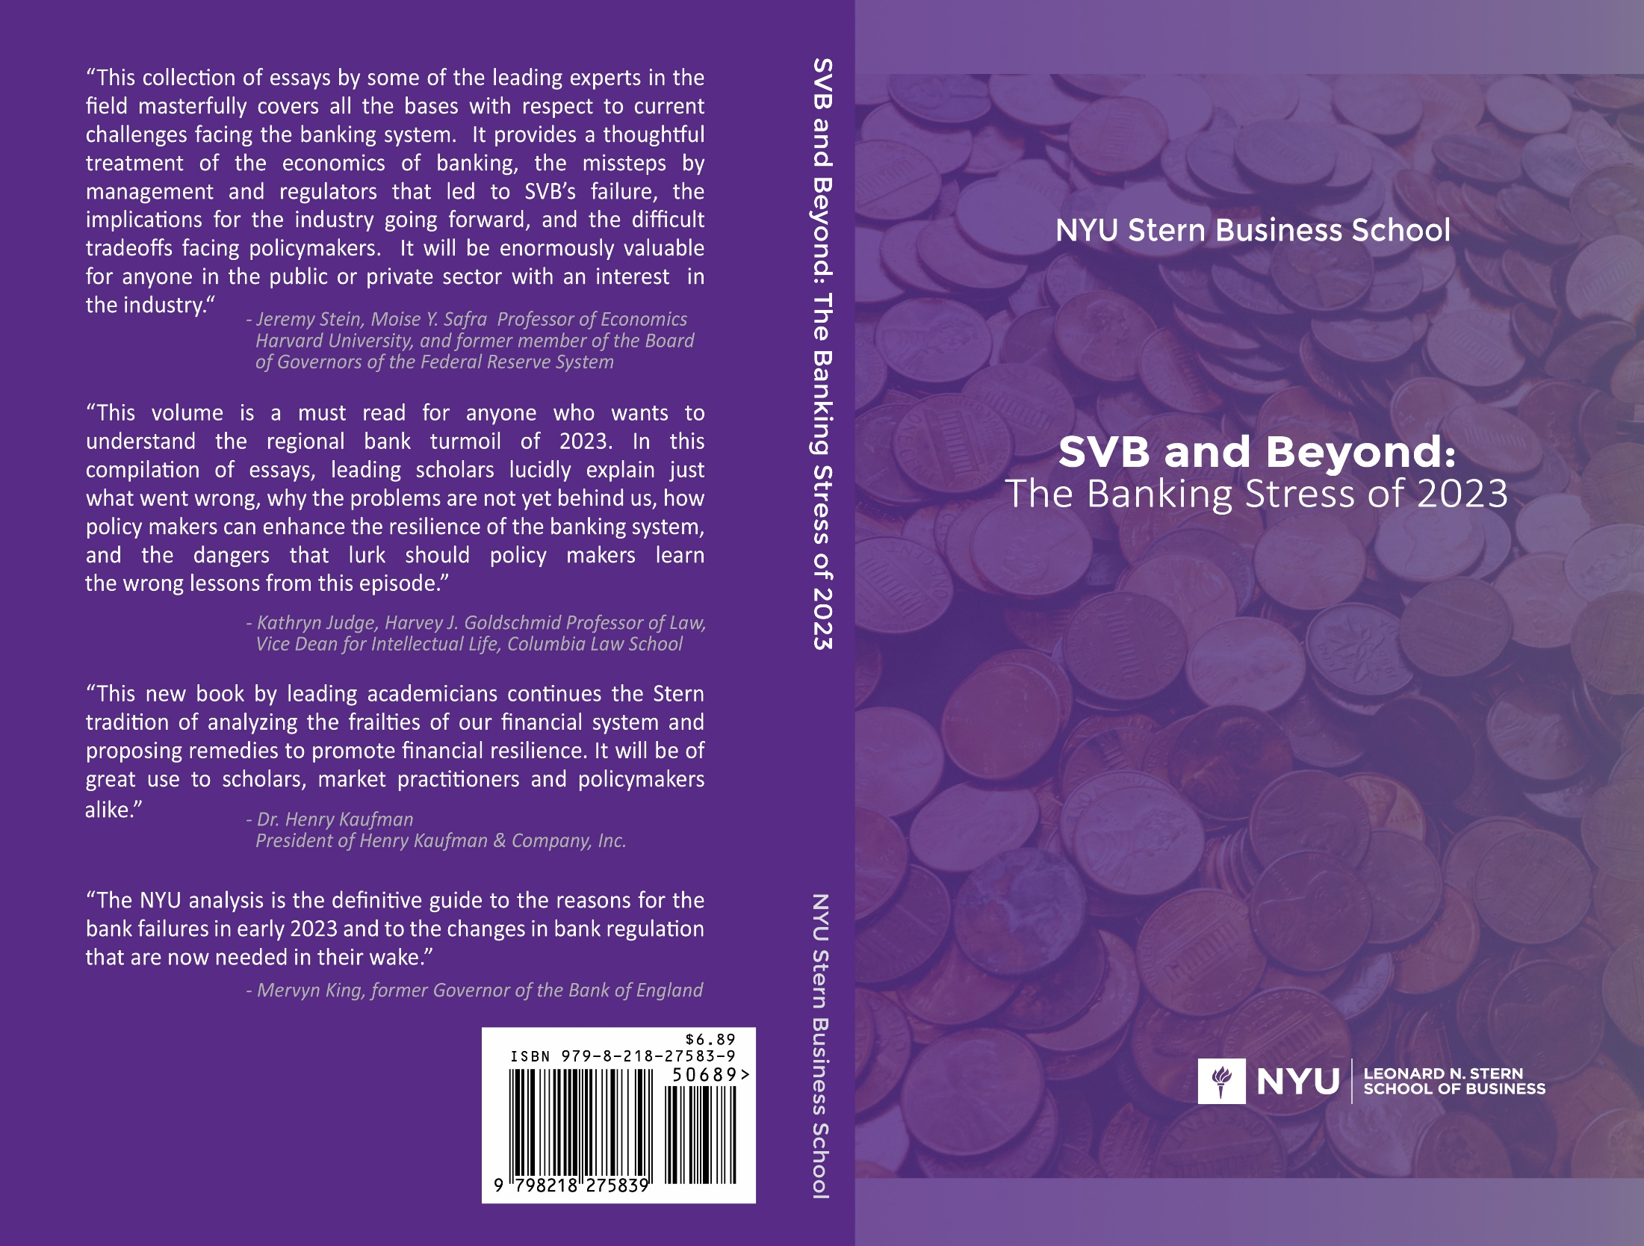


Slide 3
Outline of the talk
Banks and Uninsured Deposits –
The Role of Quantitative Easing (Chapters 1-2 and based on “Liquidity Dependence and the Waxing and Waning of Central Bank Balance Sheets”, by Viral V Acharya, Rahul Chauhan, Raghuram G Rajan and Sascha Steffen)
  Earlier version “Liquidity Dependence: Why Shrinking Central Bank Balance Sheets is an Uphill Task”, presented at Jackson Hole Economic Symposium 2022)
II. Banks, Uninsured Deposits and Interest-rate Risk –
The Value of a Market Equity based Stagflation Stress-Test (Chapter 6)

Slide 4
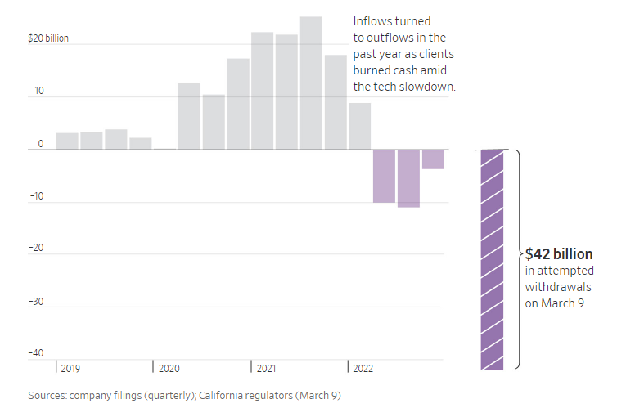
I. Leading example: SIVB deposits, quarterly net change
> $100 billion
increase in
(uninsured) deposits
ZLB + Quantitative Easing
Quantitative
Tightening
+ Rate Hikes

Slide 5
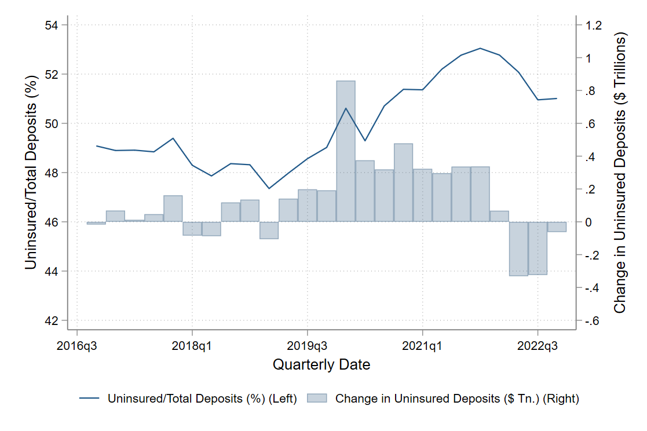
Not just SIVB … > $3.5 trillion increase in
Banking sector’s uninsured deposits
QT
+ Rate Hikes
ZLB + Quantitative Easing
ZLB + Quantitative Easing

Slide 6
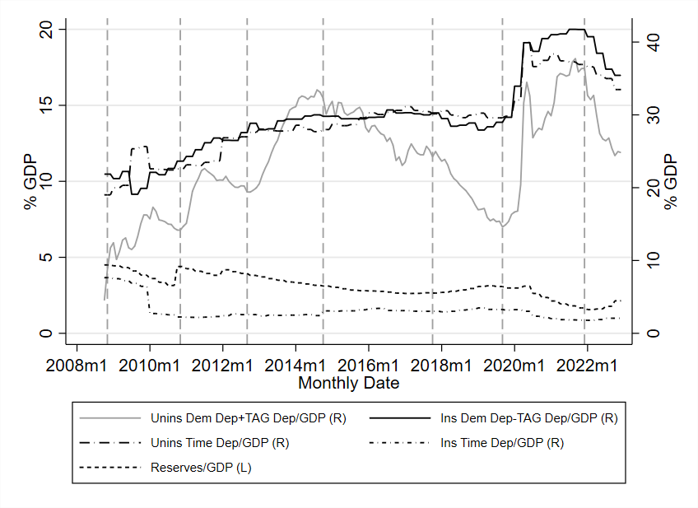
QE associated with growth of Demandable Uninsured Bank Deposits
QE I
QE II
QE III
Post-QE
Pandemic QE
QT I
QT II
Notes:
The blue line in this figure are time deposits (CDs), the red line is demand deposits (checking, savings, money-market savings, etc.), and green line is the aggregate reserves. All are plotted relative to GDP.
By decomposing deposits into time deposits and non-time or demandable deposits we see that time deposits shrink substantially during QE, stabilize some during post-QE and even rise during QT, whereas demand deposits rise more than one for one during QE, keep growing post-QE, and come down relative to GDP only marginally so during QT.
In the paper, we show that these effects are driven almost entirely by the uninsured portion of deposits.
Maturity-shortening of bank deposits is thus another dimension of liquidity dependence induced by QE, which makes QT potentially an uphill task.

Slide 7
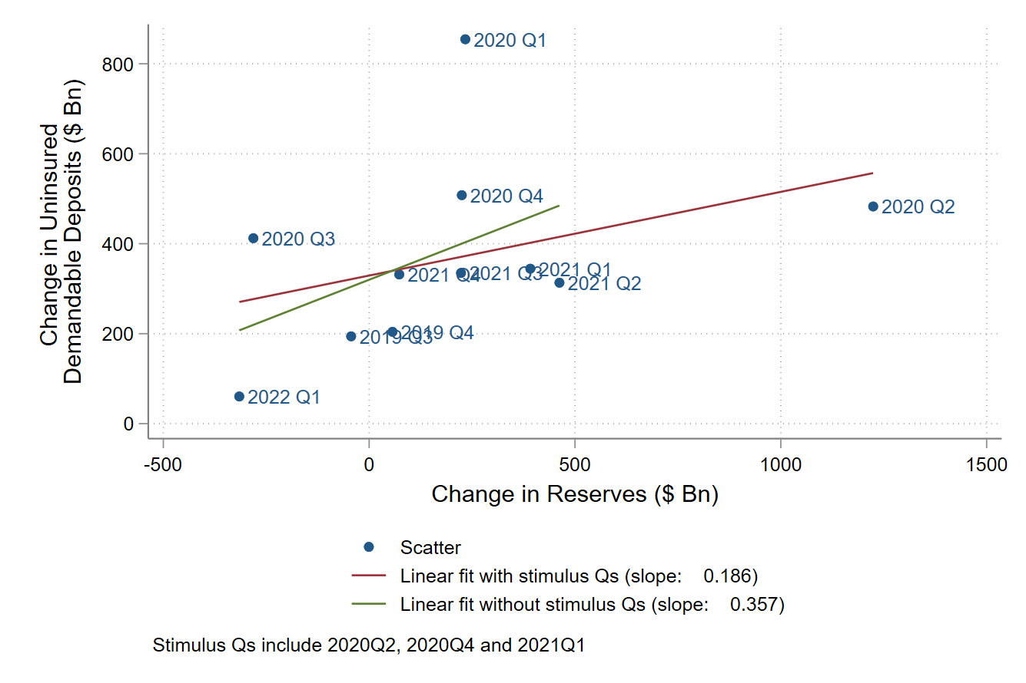
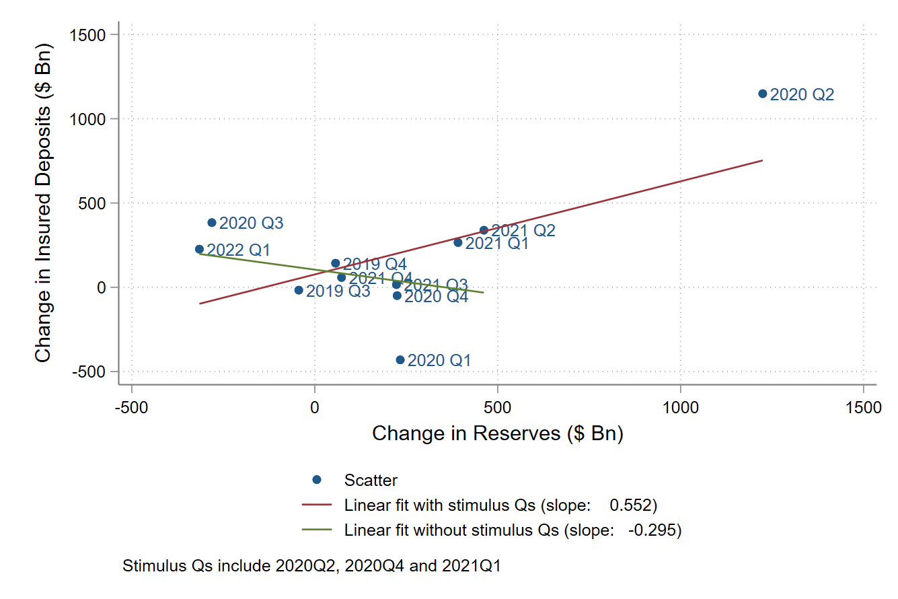
Uninsured vs Insured Deposits during
Pandemic: QE or Fiscal stimulus?
Insured deposits driven by fiscal stimulus, uninsured deposits by QE and stimulus

Slide 8
A Key Insight
Unprecedented expansion of central bank balance sheets since the GFC
Such QE is not just an expansion of central bank balance sheets
QE is typically also an expansion of commercial bank balance sheets, on the liability side via the growth of uninsured deposits (see next slide)

Slide 9
Typical QE: Purchase from public/non-banks
Initial Balance Sheet Conditions
The Fed Purchases Assets from the Public
Balance Sheet Effects
Bank balance sheets expand, financed with deposits (typically wholesale or uninsured)
FEDERAL RESERVE
Assets | Liabilities
Treasury securities | Reserves held by banks Cash held by the Treasury
FEDERAL RESERVE
Assets | Liabilities
Treasury securities +$1 | Reserves held by banks +$1 Cash held by the Treasury
BANKING SECTOR
Assets | Liabilities
Treasury securities Reserves at the Fed | Deposits Capital
PUBLIC
Assets | Liabilities
Deposits Treasury securities | Net worth
BANKING SECTOR
Assets | Liabilities
Treasury securities Reserves at the Fed +$1 | Deposits +$1 Capital
PUBLIC
Assets | Liabilities
Deposits +$1 Treasury securities -$1 | Net worth
Source: “How the Fed Changes the Size of its Balance Sheet” (Leonard, Martin and Potter, Liberty Street Economics, 2017)
Notes:
In the second way that the asset swap can take place, the non-bank sector (say the public) sells eligible assets to the central bank. The payment is deposited in commercial banks; banks add reserves to their assets and these are effectively “financed” by deposits of the non-bank financial sector that engaged in asset swap with the Fed.
Without any indirect or multiplier effects via the bank balance-sheet, there is a one for one expansion of banking sector balance-sheet with reserves. Importantly, its deposits, which typically are wholesale demandable deposits, expand with reserves.
Given these different ways that Fed expansion of balance-sheet affects the banking sector, the following questions arise:
How does Fed balance-sheet expansion affect the size and demandable deposit base of the banking sector?
Do other demandable liabilities issued by banks also grow because of the availability of reserves?
If banking sector liabilities grow, do they reverse via the same mechanism when the Fed shrinks its balance-sheet?

Slide 10
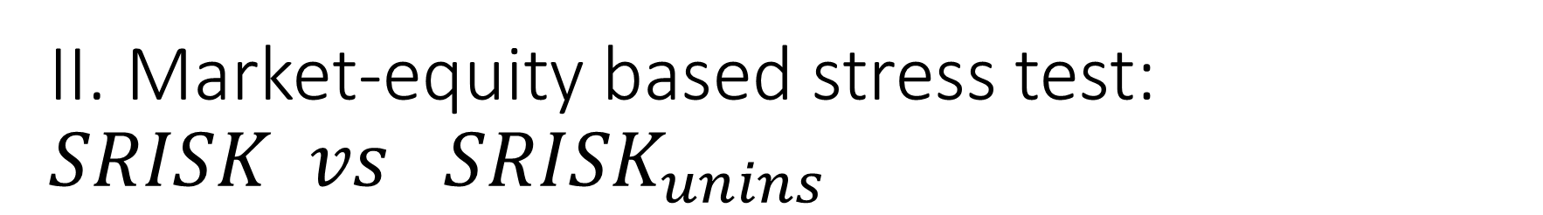
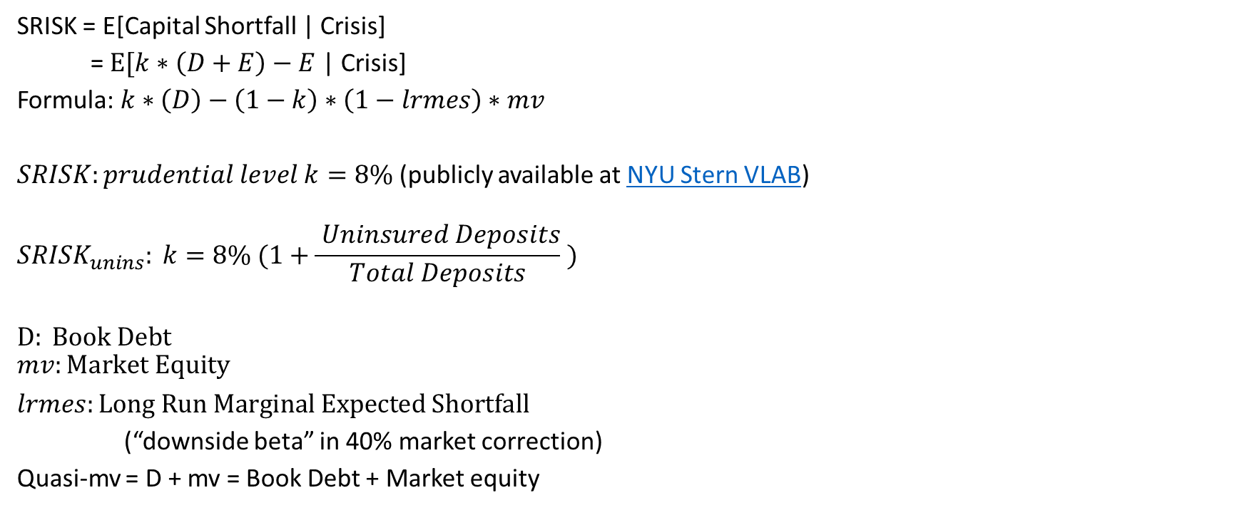
II. Market-equity based stress test: $SRISK vs{ SRISK}_{unins}$
SRISK = E[Capital Shortfall | Crisis]
= $E[k∗\left(D+E\right)−E$ | Crisis]
Formula: $k∗\left(D\right)−\left(1−k\right)∗\left(1−lrmes\right)∗mv$
$SRISK:prudential level k=8\%$ (publicly available at NYU Stern VLAB)
$${SRISK}_{unins}: k=8\% (1+\frac{ Uninsured Deposits}{Total Deposits} )$$
$$D: Book Debt$$
$$mv:Market Equity$$
$lrmes:Long Run Marginal Expected Shortfall$
(“downside beta” in 40% market correction)
Quasi-mv = D + mv = Book Debt + Market equity

Slide 11
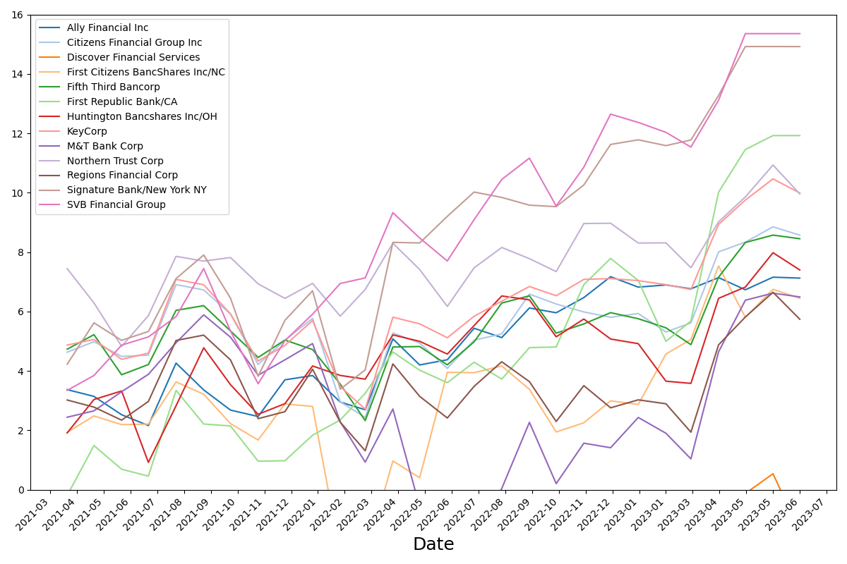

Time series of ${SRISK}_{unins}/QuasiMV$
Banks with Book Assets: 100~250bn

Slide 12
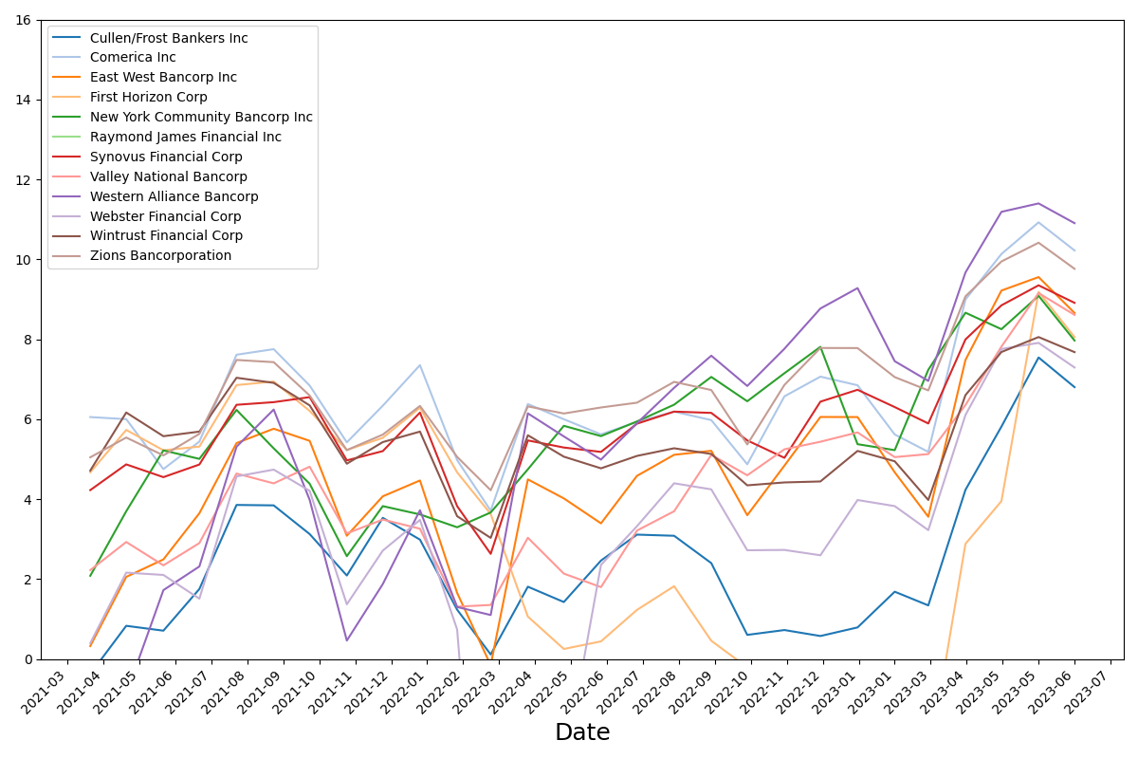

Time series of ${SRISK}_{unins}/QuasiMV$
Banks with Book Assets: 50~100bn

Slide 13
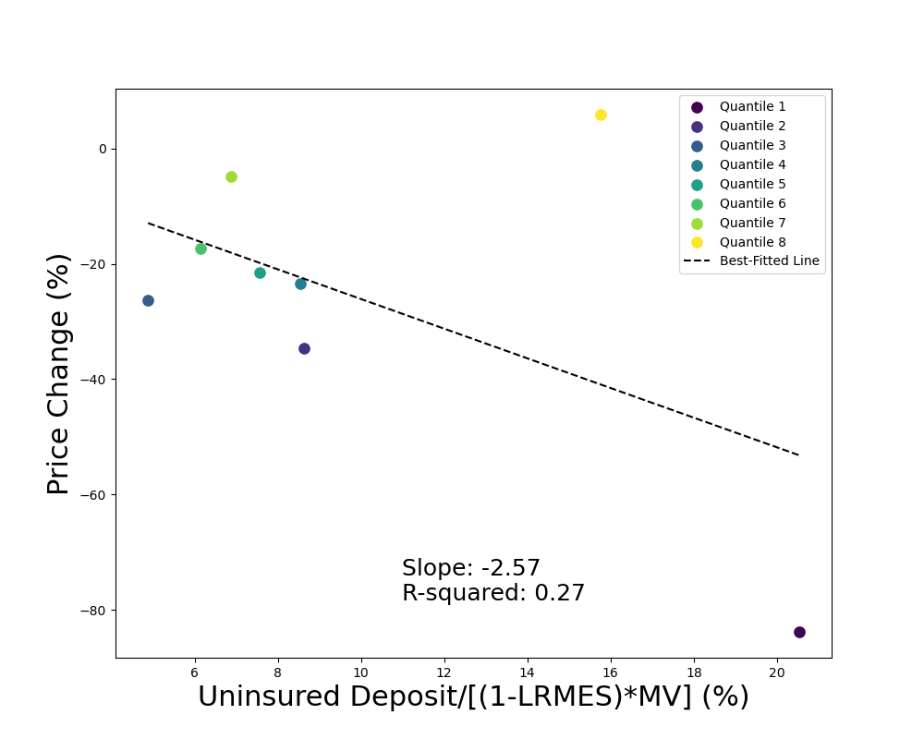
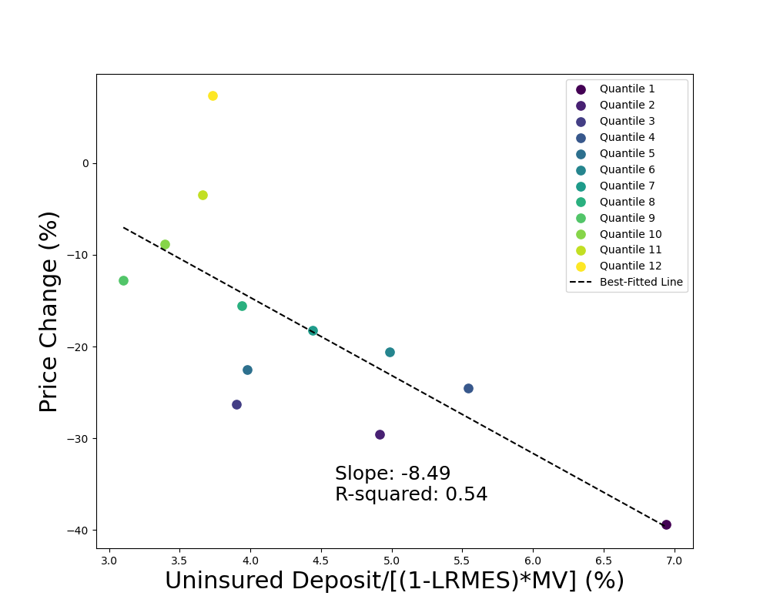
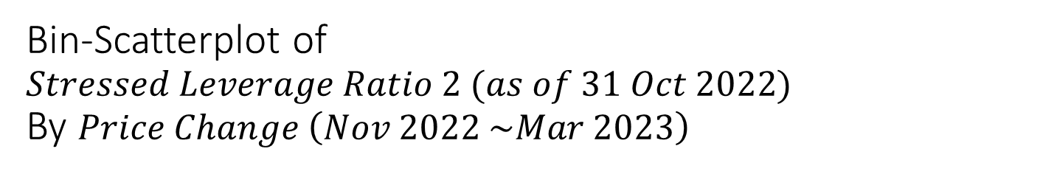

Bin-Scatterplot of $Stressed Leverage Ratio 2 (as of 31 Oct 2022)$
By $Price Change \left(Nov 2022 \sim Mar 2023\right)$
$$Stressed Leverage Ratio 2: \frac{uninsured deposit}{\left(1−lrmes\right)∗MV}$$
Bank Size: >50bn
Bank Number: 31
Bank Size: 1~50bn
Bank Number: 239

Slide 14
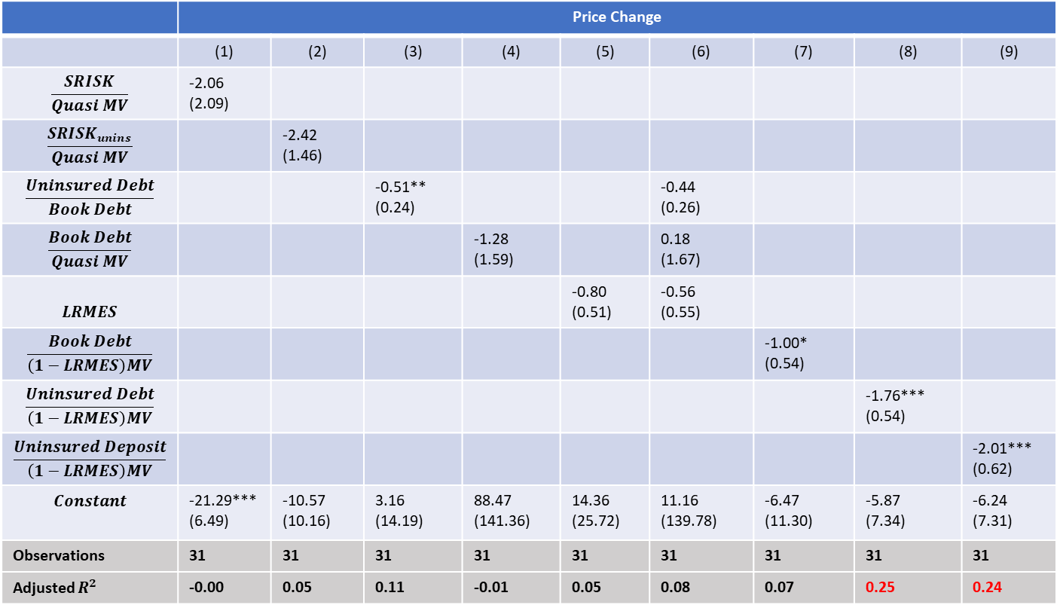
Price Change Regression Table
Bank Size: >50bn
 | Price Change
 | (1) | (2) | (3) | (4) | (5) | (6) | (7) | (8) | (9)
$$\frac{SRISK}{Quasi MV}$$ | -2.06 (2.09)
$$\frac{{SRISK}_{unins}}{Quasi MV}$$ |  | -2.42 (1.46)
$$\frac{Uninsured Debt}{Book Debt}$$ |  |  | -0.51** (0.24) |  |  | -0.44 (0.26)
$$\frac{Book Debt}{Quasi MV}$$ |  |  |  | -1.28 (1.59) |  | 0.18 (1.67)
$$LRMES$$ |  |  |  |  | -0.80 (0.51) | -0.56 (0.55)
$$\frac{Book Debt}{\left(1−LRMES\right)MV}$$ |  |  |  |  |  |  | -1.00* (0.54)
$$\frac{Uninsured Debt}{\left(1−LRMES\right)MV}$$ |  |  |  |  |  |  |  | -1.76*** (0.54)
$$\frac{Uninsured Deposit}{\left(1−LRMES\right)MV}$$ |  |  |  |  |  |  |  |  | -2.01*** (0.62)
$$Constant$$ | -21.29*** (6.49) | -10.57 (10.16) | 3.16 (14.19) | 88.47 (141.36) | 14.36 (25.72) | 11.16 (139.78) | -6.47 (11.30) | -5.87 (7.34) | -6.24 (7.31)
Observations | 31 | 31 | 31 | 31 | 31 | 31 | 31 | 31 | 31
Adjusted $R^{2}$ | -0.00 | 0.05 | 0.11 | -0.01 | 0.05 | 0.08 | 0.07 | 0.25 | 0.24

Slide 15
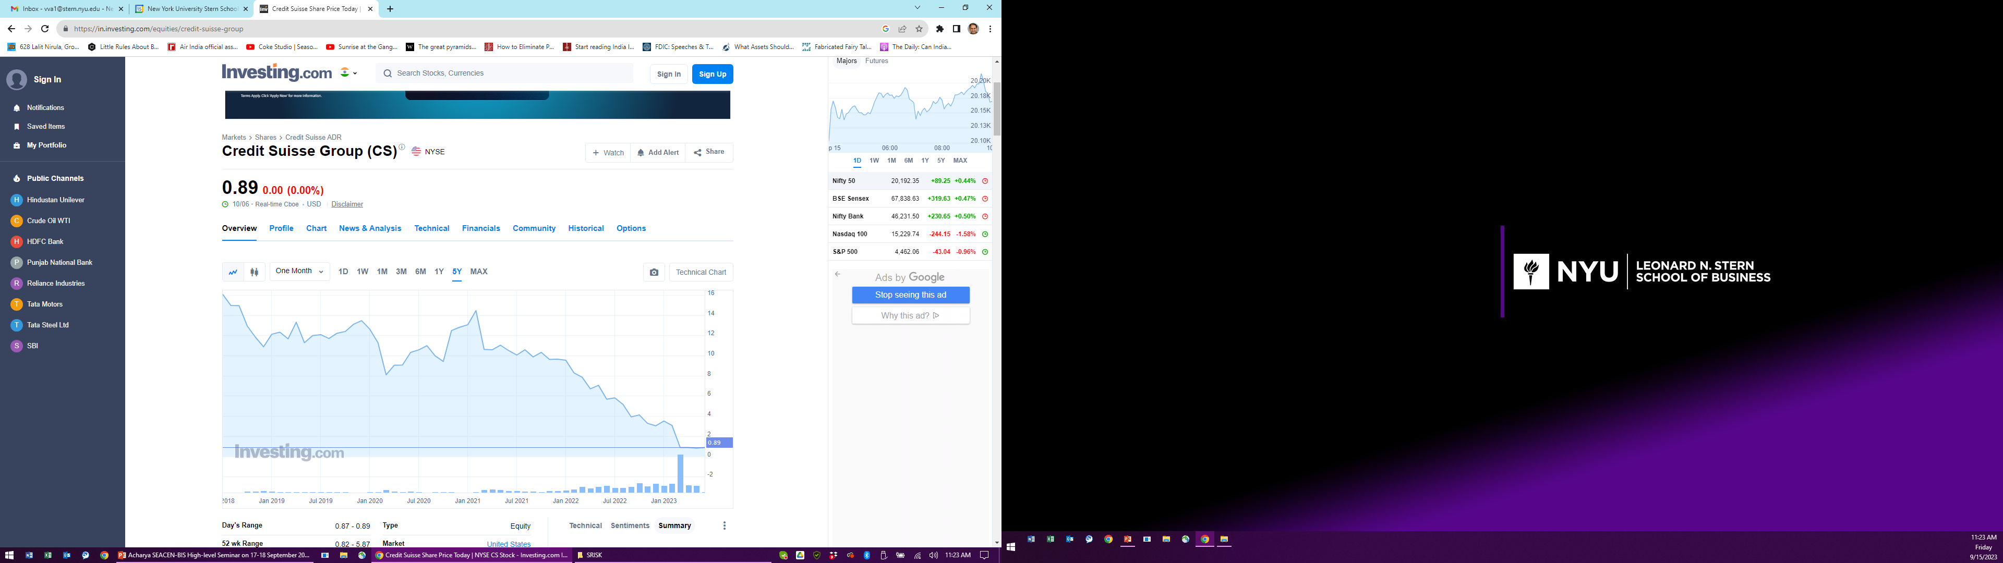
Europe (CS): Pay attention to Market Equity!
>75% steady market drop from
1 Feb 2021 to March 2023

Slide 16
So what should be done with banks now?
Backstop it all, provide guarantees?
  This helps stem runs, but does not restore confidence or bring down the vol, as in 2007-09
  Another variant of risk-seeking: Remaining under-capitalized. Healthier banks may skip too
  The social problem is to produce the “optimal” quantity of deposits, so get risks internalized
What worked in the past can provide some guidance…

Slide 17
G1: Required to raise capital after stress test of Feb-May 2009
G2: Not required to raise capital after stress test
Source: Chapter 4, “Measuring Systemic Risk”,
Viral V. Acharya, Christian Brownlees, Robert Engle,
Farhang Farazmand, and Matthew Richardson, in Regulating Wall Street, NYU Stern (Wiley), 2011.

Slide 18
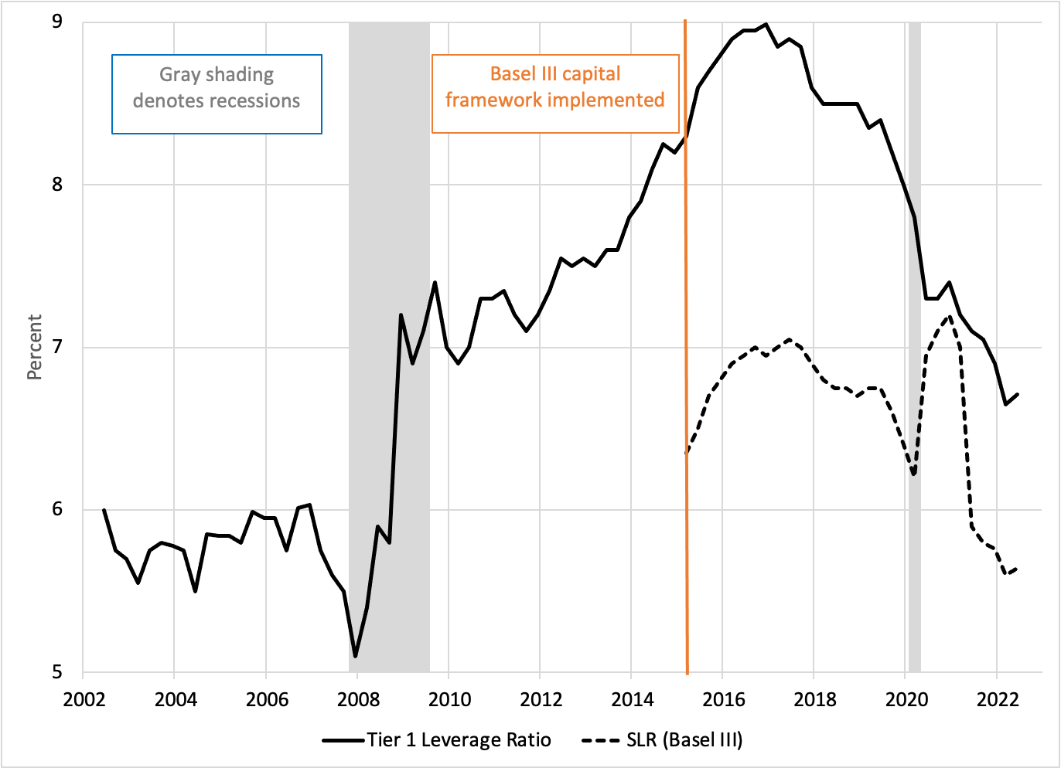
G-SIB Capital Ratio: Crisis Regulatory Cycle
Crisis Regulatory Cycle
2008: Crisis triggers G-SIB recapitalization
2010: Dodd-Frank introduces annual stress tests (boosts effective capital requirements)
2017: New Admin aims to scale back Dodd-Frank rules
2018: S. 2155 relaxes regulations (especially on midsize banks)
2019: Fed eases supervision of midsize banks
2023: Midsize bank crisis
2023: New bank rules …
Note: Jun 2020-Mar 2021 SLR (Basel III) ratio bounce reflects Fed’s COVID-period definition of exposure (denominator).
Source: Interpolated from Chart 1 of FRB KC Bank Capital Analysis, 2Q 2022

Slide 19
The Case for a Stagflation Stress Test
Stress test + capital-raising, as in Feb-July 2009, for stagflation (poly-crisis)
  Mark capital honestly in Asset Quality Review for rate hike + recession + house-price declines + decline in commercial real estate (CRE)
    Stress it for plausible losses and cross-check with independent metrics like NYU Stern’s SRISK
  Get banks to raise capital or sell assets/franchise to more valuable banks
  If not raise it for them via government-funded (preferred) stakes in equity
  If done well, government funds might not be required as in 2009
Give some formulaic concession in marking-to-market (MTM) of assets based on truly stable, insured, retail deposit base of banks

Slide 20
Regulatory Challenge
Robustness to the risk that risks will change
Does the stress test capture risks that are present and clear?
It is best to assume uninsured debts might be all due and payable
  Diagnosis: (Fragile) Deposit franchise vs Manufacturing tail risk / Carry trades ?
  Regulation should be robust to this model risk
  Regardless of the diagnosis, safe to raise bank capital -> lower uninsured deposits
  Recognize the fiscal limits on deposit insurance, guarantees, the size of Fed’s put, etc.

