Slide 1
SVB and Beyond…Chapter 7: Expanding Mark-to-Market Accounting for Banks’ Debt Investment Securities and Regulatory Capital
Sehwa Kim, Columbia University
Seil Kim, Baruch College, City University of New York
Stephen G. Ryan, New York University
CEPR Webinar, September 29, 2023

Slide 2
A Little Accounting and Bank Regulatory Background
Since 1993 under FAS 115 (now ASC 320), banks and other firms classify and account for debt investment securities in three distinct ways depending on their asserted (and unobservable) intent regarding the securities
Classification | Required Intent | Balance Sheet Measurement | Periodic Unrealized Gains/Losses
Held to maturity (HTM) | Intent and ability to hold to maturity | Amortized cost | Not recognized
Available for sale (AFS) | None (catchall for no firm intent) | Fair value | Recognized in accumulated other comprehensive income (AOCI)
Trading | Intent to trade | Fair value | Recognized in net income

Slide 3
A Little Background (2)
As depicted in the following slide, banks experienced large unrealized losses on debt investment securities as interest rates rose sharply beginning in late 2021
Banks’ non-recognition of unrealized gains and losses on HTM securities, as well as on AFS securities on the income statement, raises two related problems
  Banks are not incentivized to manage the interest rate and other risks of their debt investment securities
  Bank stakeholders (including regulators) may not appreciate the effects of past and potential future realizations of these risks

Slide 4
Magnitude of Unrealized Losses on Sample Banks’ Debt Investment Securities

Slide 5
A Little Background (3)
The FASB issued FAS 115 in 1993 in the wake of the thrift (S&L) crisis, which had been prolonged by banks’ non-recognition of unrealized losses on fixed-rate assets
  The SEC pushed for market value accounting for all marketable securities
  But banks, insurance companies, and their regulators pushed back, noting that their deposits and other liabilities (imperfect economic hedges) are measured at amortized cost
  FAS 115’s creation three classes of debt investment securities with different accounting was a political compromise
  A 1995 SEC staff speech created the rule that the sale or reclassification of a HTM security except in the limited circumstances expressed permitted by FAS 115* would “taint” the firm’s entire HTM securities portfolio, preventing the classification of any securities as HTM for a 2-year tainting period. The FASB promptly incorporated this rule into GAAP
______
  * Under FAS 115, a firm can only sell or reclassify a HTM security without taint if
    One of six specified conditions are met, with no ability to analogize—significant (1) deterioration of issuer creditworthiness, (2) change in tax law, (3) business combination or disposition, (4) change in regulation regarding permissible investments, (5) increase in regulatory capital requirements, and (6) increase in regulatory risk weights—or
    An “extreme disaster scenario” occurs that is “isolated…non-recurring…unusual for the reporting entity…and could not be reasonably anticipated”
  In addition, the FASB sometimes writes standards that affect the accounting for HTM securities and allows one-time reclassifications

Slide 6
A Little Background (4)
Upon their initial adoption of FAS 115 at the end of 1993, banks on average classified approximately half of their portfolios as each of AFS and HTM
In 1994, the Federal Reserve raised the target federal funds rate sharply, leading interest rates to follow a very similar path to the one followed since late 2021. The increased in interest rates yielded unrealized losses on fixed-rate debt investment securities. For AFS securities, these unrealized losses were recognized in AOCI, which at the time was included in regulatory capital. Banks’ inability to sell or reclassify HTM securities without tainting the HTM portfolio made it difficult to manage their risks
To help preserve banks’ capital, in January 1995, bank regulators imposed the AOCI filter, which excludes AOCI from regulatory capital
At the end of 1995, FASB provided a “one-time” moratorium that allowed firms to reclassify HTM securities as AFS without taint

Slide 7
A Little Background (5)
As detailed on the following slide…
Under the U.S. implementation of Basel III, the AOCI filter was phased out over a 5-year period beginning in 2014 for ~15 advanced approaches banks with assets over $250 billion or foreign exposure over $10 billion
Under the Economic Growth, Regulatory Relief, and Consumer Protection Act of 2018 and the associated 2019 “Tailoring Rules” of the Federal Reserve, the AOCI filter was reinstated at the end of 2019 for previously advanced approaches banks with assets from $250-700 billion and foreign exposures below $75 billion if the banks chose to opt-out from the inclusion of AOCI in regulatory capital

Slide 8
Three Classes of Banks for Regulatory Purposes
Class of Bank | AOCI Filter | Banks
Advanced Approaches (AA) GSIBs and non-GSIBs with ≥$250 billion assets or ≥10 billion foreign exposure up to 2019Q3 ≥700 billion assets or ≥75 billion foreign exposure beginning in 2019Q4 | AOCI filter phased out over five years beginning in 2014Q1 | JP Morgan Bank of America Citigroup Wells Fargo Goldman Sachs Morgan Stanley BNY Mellon State Street Northern Trust
Opt-out Advanced approaches banks prior to 2019Q4 with $250 billion ≤ assets < $700 billion or $10 billion ≤ foreign exposure < $75 billion | AOCI filter reinstated in 2019Q4 | Capital One Financial Charles Schwab PNC Financial US Bancorp American Express
Non-Advanced Approaches (non-AA) | AOCI filter throughout the 2012Q1-2022Q4 sample period | All other banks

Slide 9
Two Related Proposals
1. Eliminate the currently allowed classification of debt investment securities as held-to-maturity (HTM). This proposal would require all debt investment securities to be measured at fair value (~market value in a hypothetical orderly transaction) on the balance sheet.
  As interest rates increased beginning in late 2021, this proposal would have required banks to record unrealized mark-to-market losses on all their fixed-rate debt investment securities on the balance sheet
2. Eliminate the regulatory AOCI filter
These proposals would require banks to recognize the effects of unrealized gains and losses on debt investment securities for financial reporting and capital purposes, thereby incentivizing banks to manage their risk of those securities

Slide 10
Banks’ Incentives for Classifying Debt Investment Securities as AFS Versus HTM
AFS
  Pluses: Unrealized gains and losses yield no income volatility and no regulatory capital volatility if AOCI filter applies; can sell or reclassify securities at will
  Minuses: Unrealized gains and losses yield GAAP owners’ equity volatility
HTM:
  Pluses: Unrealized gains and losses yield no income volatility, no owners’ equity volatility, and no regulatory capital volatility
  Minuses: Artificial illiquidity from HTM tainting rule

Slide 11
Preferred Classifications of Securities by Class of Bank
Sample Subperiod | Pre-Basel III 2012Q1-2013Q2 | Basel III 2013Q3-2019Q3 | Tailoring Rules 2019Q4-2021Q3 | Interest Rate Increases 2021Q4-2022Q4
Class of Bank
Advanced approaches | AFS | HTM | HTM | HTM
Opt-out | AFS | HTM | AFS | HTM
Non-advanced approaches | AFS | AFS | AFS | HTM
The effects of these incentives are observable for all three classes of banks, but are particularly apparent for the opt-out banks—these banks first asserted they had the intent to hold securities to maturity in the Basel III period, then that they did not in the tailoring rules period, and finally that they did again in the interest rate increases period

Slide 13
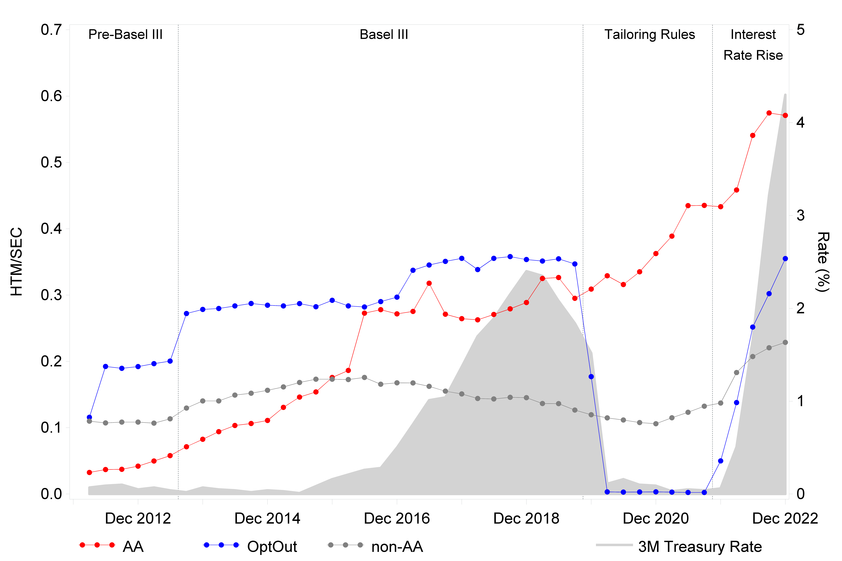
Proportion of Securities Classified as HTM each Year by Bank Class
Figure 2, Panel C from Kim, Kim, Ryan (2023 working paper)

Slide 14
Rationales for Transfers from HTM to AFS
The opt-out banks primarily invoked the tailoring rules as the rationale for transferring debt investment securities from HTM to AFS during the tailoring rules period (see the following slide). These banks did not taint their HTM portfolios (without any objection from their Big 4 auditors), despite the tailoring rules not meeting any of the criteria for transferring securities out of HTM without taint.

Slide 16
Sample Banks’ Stated Reasons for Transfers from HTM to AFS during Sample Period
Reason for Transfer | Frequency | Percent
ASU 2017-12 | 41 | 34.8
taint HTM portfolio | 39 | 33.1
ASU 2019-04 | 14 | 11.9
tailoring rules | 5 | 4.2
Volcker rule | 4 | 3.4
credit deterioration | 3 | 2.5
merger | 3 | 2.5
other - not taint HTM portfolio | 2 | 1.7
ASU 2020-04 | 2 | 1.7
Basel III | 2 | 1.7
COVID-19 | 1 | 0.9
Office of Management and Budget rule reducing interest subsidies for certain municipal (Build America) bonds | 1 | 0.9
close to maturity | 1 | 0.9
Total | 118 | 100
Table 1, Panel E, from Kim, Kim, Ryan (2023) working paper

Slide 17
Risk Management
The reinstatement of the AOCI filter under the tailoring rules appears to have led the opt-out banks to increase the interest rate risk of their AFS debt investment securities
This occurred while the banks’ percentage of uninsured and thus runnable deposits increased sharply.

Slide 19
Conclusions
Banks’ classifications of securities are fluid and primarily reflect their preferred financial and regulatory accounting effects, not distinct economic motivations
The AOCI filter encourages bank risk taking in AFS securities
Our results support the elimination of HTM classification/amortized cost accounting and the AOCI filter

Slide 20
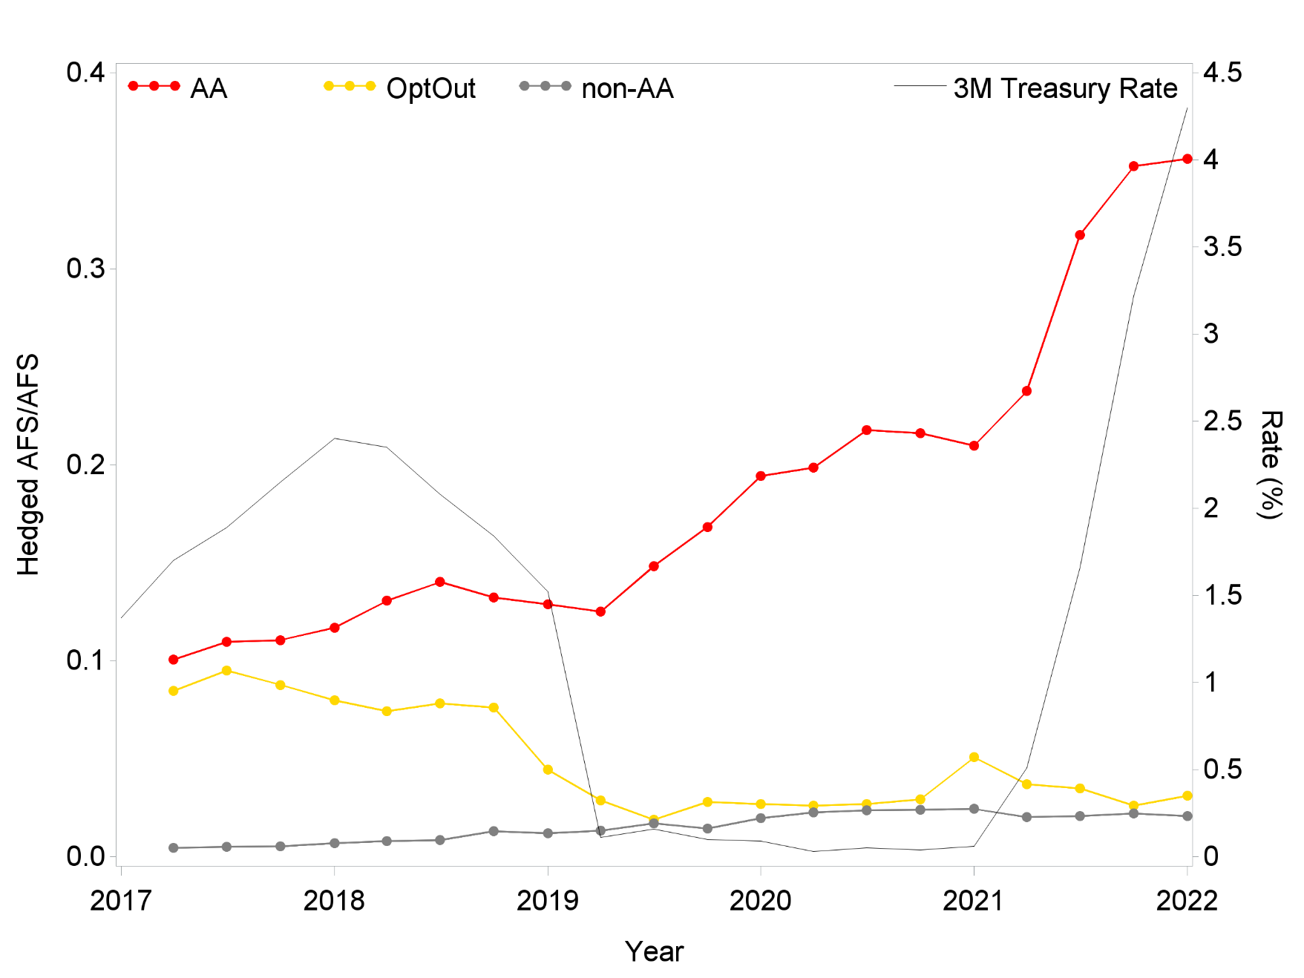
Supplemental Materials: Proportion of AFS Securities that are Hedged Item in Fair Value Hedge by Bank Class
Figure 6 from Kim, Kim, Ryan (2023) working paper

Slide 21
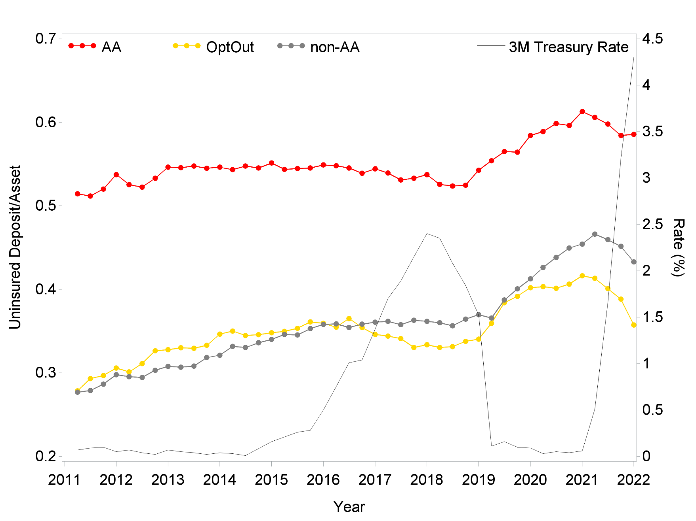
Supplemental Materials: Proportion of Deposits that are not FDIC Insured each Year by Bank Class
Figure 7 from Kim, Kim, and Ryan (2023) working paper

