Slide 1

Managing allowance price risk in the new EU emissions trading architecture
Prof. Christian Flachsland
14th CEPR/EAERE Webinar Series on Climate Policy
15 November
Notes:
https://www.cuddlynest.com/blog/tiergarten-charlottenburg-berlin-guide/

Slide 2
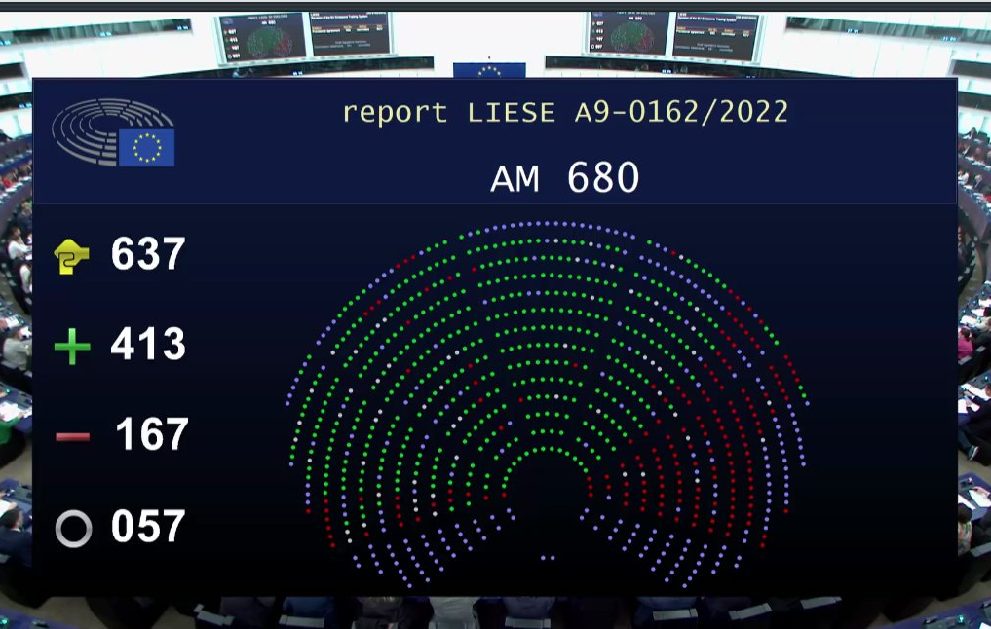
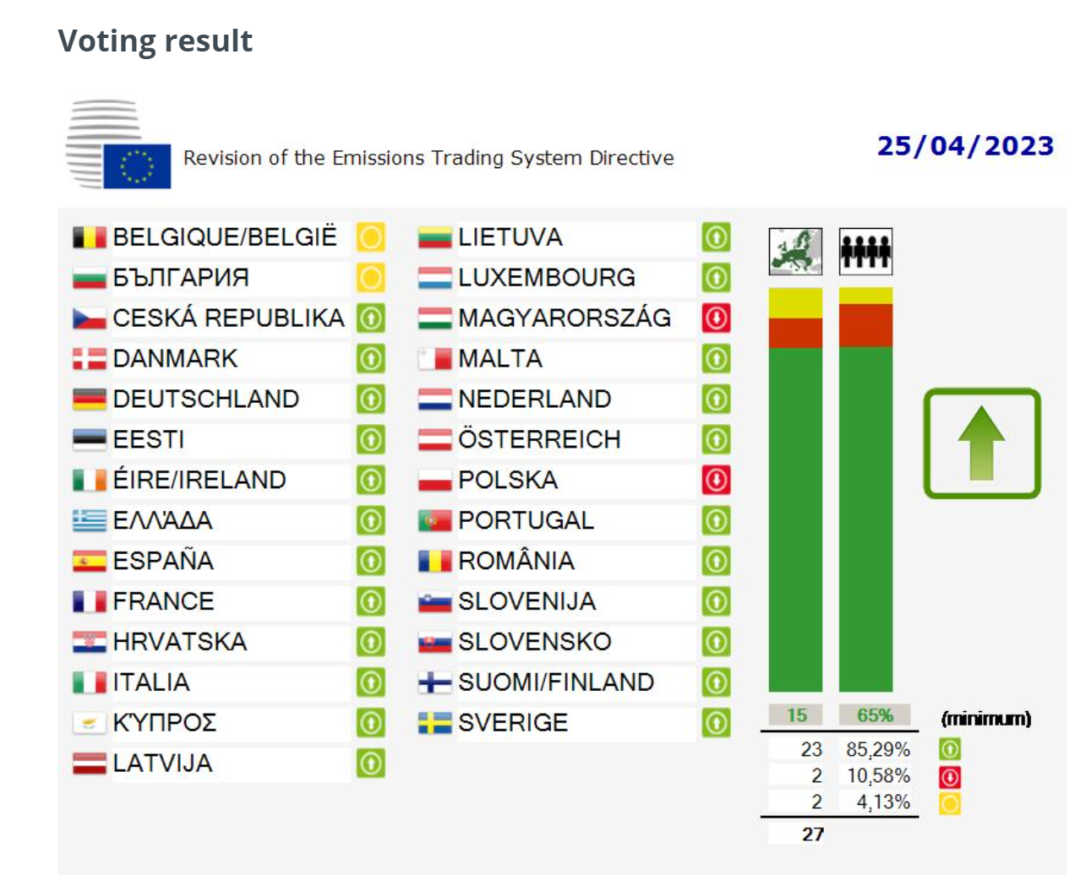
Main message
With the introduction of the EU ETS2 as part of the Fit-for-55 package, the EU has set up a comprehensive and ambitious climate policy architecture.
Two key challenges over the next years:
Ensuring the political survival and environmental integrity of this architecture
Making sure carbon pricing contributes to effectively shifting investments
Two complementary policy options appear particularly promising:
Introduce price collars in the EU ETS1 & 2 (to address both political & investment challenges)
Carefully designed compensatory measures in Social Climate Plans (to partly address political challenge)
Flis 2023
EU Council 2023

Slide 3
EU climate policy architecture after Fit-for-55 reform
Carbon pricing architecture after Fit-for-55 reform
Target: Overall -55% GHG by 2030 (compared to 1990)
Power / Energy
Industry
Aviation & Shipping
Road transport
Buildings
Waste, agriculture fluorinated gases, …
Land-use, land-use change and forestry
EU ETS-1
- 61% GHG by 2030 (compared to 2005)
EU ETS–2
- 43% GHG by 2030 (compared to 2005)
At least -310 Mt CO₂ removals
Effort-sharing
Regulation (ESR)
- 40% GHG by 2030 (compared to 2005),
27 Member State targets ranging from -50% to -10%

Slide 4
New cap trajectories in the EU ETS1 and EU ETS2
From 2027, the EU ETS1&2 will cover ~80% of all EU GHG emissions (rest: ESR)
*
Phase 3
Now
-43% r.t. 2005
Before Ff55
-5,38% p.a.
-61% r.t. 2005
-4,4% p.a.
Preliminary Assessment, based on Article 30c of revised ETS Directive
2039*
(Now)
2057
(Before
Fit-for-55)
2045
*Supply of aviation allowances (EUAA) will reach zero by 2045,
only around 150 Mt cumulated supply after 2039.
Source: Pahle 2023

Slide 5

Modeling of ETS2 prices
400 €/t
350 €/t
Hardly any additional instruments modeled
Low tech. Progress & energy efficiency improvements, high GDP...
Wide range of price projections, depending on model assumptions
Modeled prices represent possibilities, not probabilities
Additional ETS design features to limit price increases (MSR2)
300 €/t
200 €/t
100 €/t
Effective additional instruments
High tech. Progress & energy efficiency improvements, low GDP, ...
45 €/t
0 €/t
EU KOM 2021, 45 €/t “soft” price cap
Pahle et al., 2023 (Ariadne)
Günther et al. (in prep)
Abrell et al., 2022 (Ariadne)
Source: Pahle 2023,
Günther, C., Govorukha, K., Osorio, S., Pahle, M. (in prep.): ETS2 price formation and projections

Slide 6


Limiting the ETS2 allowance price to 45€?
“I think when the ETS II starts in 2027, the price will be significantly lower [than 45€].”
P. Liese, EPP, 19.12.2022
(EP ETS Revision Rapporteur)
„The [ETS2] price is capped at 45€ until 2030.“
M. Bloss, Greens, 18.12.2022
(EP ETS Revision shadow rapporteur)

Slide 7
Price & quantity management provisions in the ETS2: the MSR2
Inception of an MSR2 (separate from MSR1)
Along with the the ETS2, a new MSR2 is established and seeded with 600mio allowances (in addition to the ETS2 cap)
I. Price triggers
Price level trigger >45€
If the avg. price exceeds 45€ (adjusted for CPI) for >2 months, 20mio. allowances [~2% of initial cap] will be released (per year)
If 6 months after the 45€ intervention the price remains >45€, the Commission is authorized to release additional volumes of allowances [unclear if 1x or several times] . (Article 30h(7))
Two price increase rate triggers
If the allowance price rises to more than x2 (initially: x1.5) above the average price of the previous 6 months (for >3 months), then 50mio. allowances are released.
If the price is >x3 times the average of the previous 6 months (for >3 months), then 150mio. allowances are released.
II. Quantity triggers
Allowances in circulation <210mio or >440mio
If total number of ETS2 allowances in circulation (TNAC2) is lower than 210mio., 100 mio allowances released via auctions p.a.
If total number of ETS2 allowances in circulation (TNAC2) is higher than 440mio., 100 mio allowances deducted from auctions p.a.
So, can we expect the MSR2 to release allowances in case of a high allowance price, thus dampening it?
No: Lessons from MSR1 suggest that anticipated future allowance scarcity can induce high current prices and high levels of banking, potentially preventing triggering the <210mio. TNAC2 provision (e.g. Borghesi et al. 2023)

Slide 8
Anticipating ETS1 & 2 linkage: (Some) instantaneous price convergence
€/tCO₂e
Significantly different prices only if no expectation of future linkage
But: Commission and e.g. German government very outspoken about linking post-2030
price
integrated
ETS
ETS-[1 or 2]
ETS-[1 or 2]
Today
Linking
Time

Slide 9
Anticipating ETS1 & 2 linkage: (Some) instantaneous price convergence
€/tCO₂e
Price differences depends on
Discounting
Expected time of linking
ETS designs
...
Investors can and will bet on future price convergence (arbitrage)
Result: (some) instantaneous price convergence
Degree of price convergence depends on multiple factors
Anticipation of linking may make activation of MSR2 price trigger provision even more likely (pressure towards ETS2 price above 45€)
Potentially: additional price volatility due to changing linking expectations
price
integrated
ETS
ETS-[1 or 2]
ETS-[1 or 2]
Today
(anticipated)
Linking
Time

Slide 10
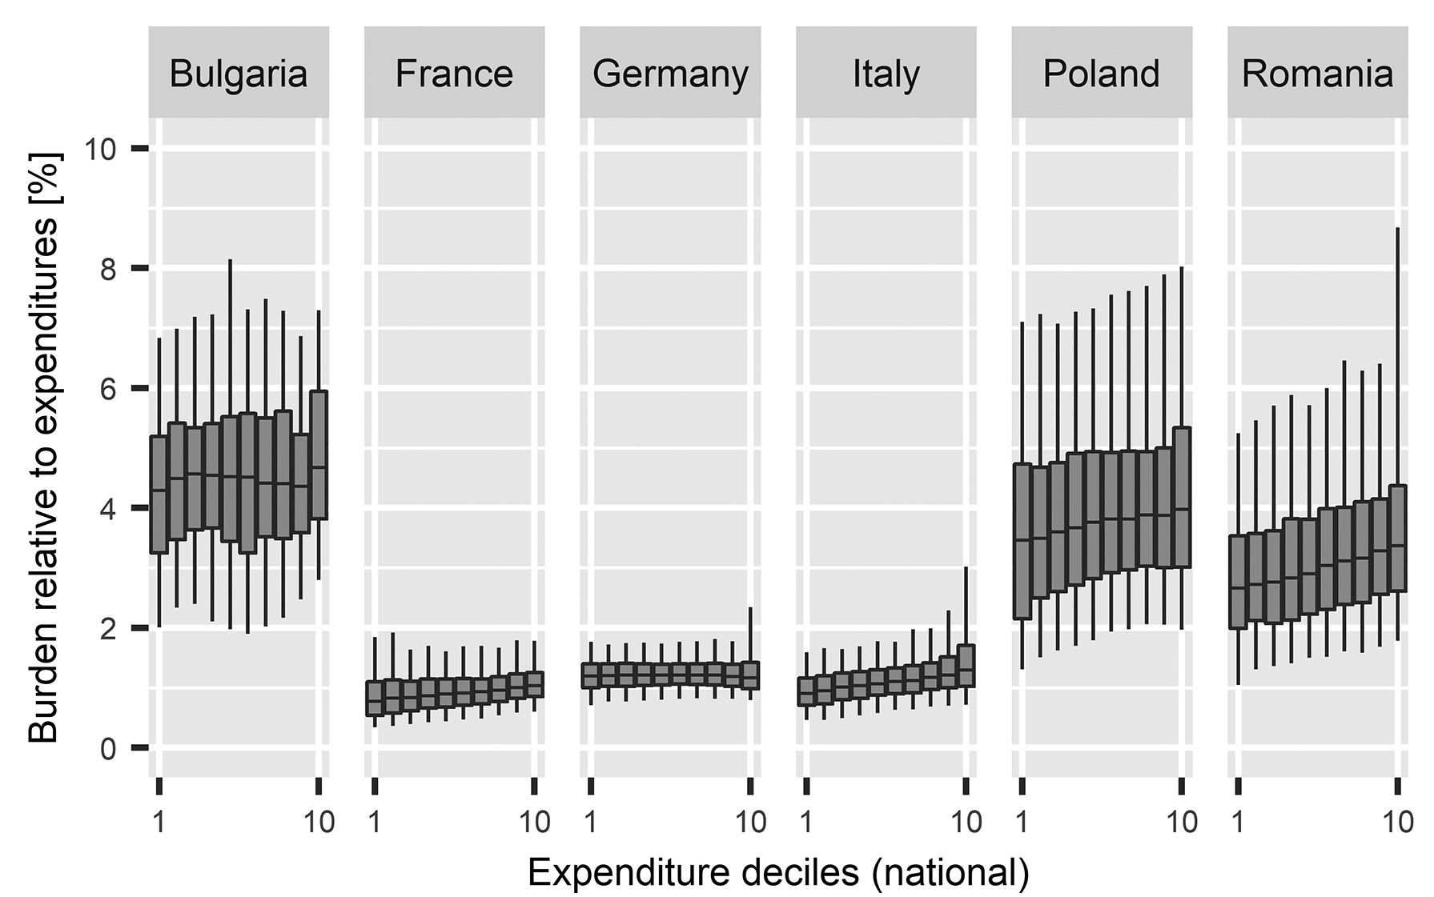
An „EU carbon price shock“ in 2027?
Distributional impacts of uncompensated carbon pricing in some EU countries can be significant
For politics: High salience of ETS2 price
Social Climate Fund (SCF) is likely insufficient
Max. cumulative €65bn 2026-2032
Does not dynamically scale with carbon price level
Transfer across countries – requires domestic implementation
SCF spending rules: green investment priorities may (need not) be at odds with social objectives
→ Designing domestic „Social Climate Plans“ will be key
Impacts of an uncompensated 25€/tCO₂
economy-wide carbon price on households
Feindt et al. 2021

Slide 11
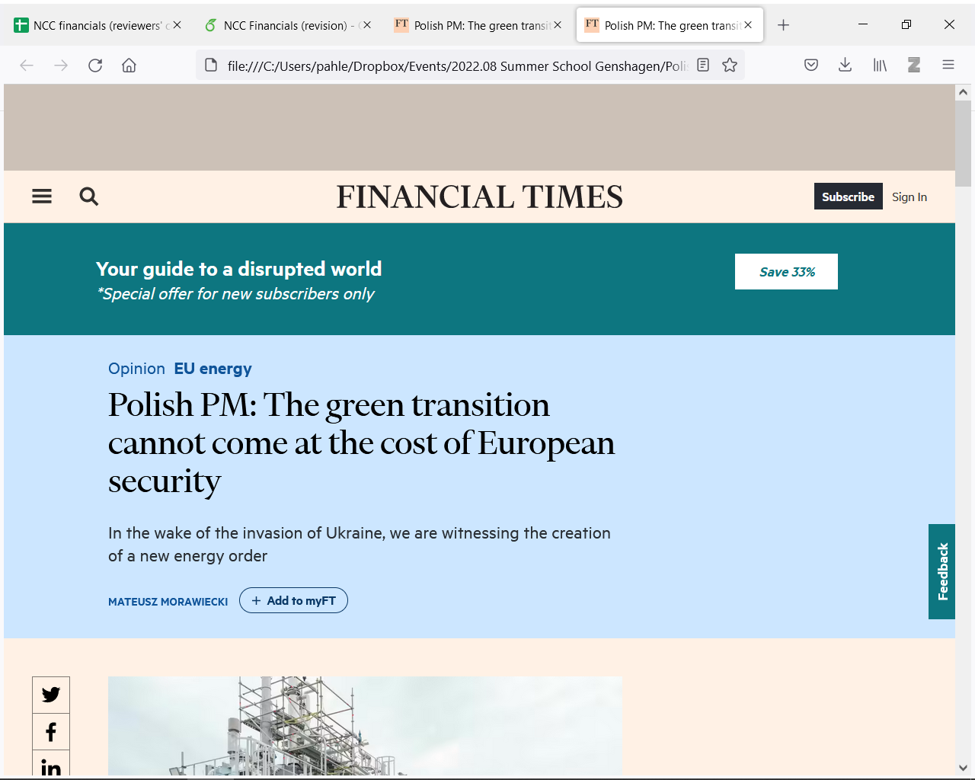
Why might high price uncertainty be a problem?
1) Risk of political ad hoc interventions, damaging environmental integrity
Distributional impacts of very high carbon prices appear politically unsustainable
Probability of ad hoc intervention depends on political environment (geopolitical and economic conditions, leadership EU COM, MS governments, ...)
Wide range of ad hoc interventions imaginable
2) Investment hold-up
If carbon pricing is a key tool to shift investment dynamics, and future allowance markets are missing + risk of political backlash → risk of investment hold-up
  How can private & corporate home and car owners, businesses, and the state take highly uncertain future carbon price trajectories into account in their investment decisions?
  Applied empirical behavioral research appears useful (incl. impacts of institutional settings, such as informational tools)
(4 July 2022)
“The Polish proposal is to freeze the ETS price at €30 for at least one year […].”

Slide 12
Different assessments of carbon price projections + political risk
Subjective probability density functions (PDF)
of expected allowance price, given current ETS2 design
Price risk
Political risk to integrity
(ad hoc intervention ,
freeze, termination etc.)
„pessimist“
 | Optimist | Pessimist
Optimist | No worries | Will (likely) be fine
Pessimist | Take precautions | Heading for disaster
„optimist“
„optimist“
Political risk
Probability
„pessimist“
low
high
Allowance price

Slide 13
Response option #1 (political & investment risk): Price collar in EU ETS1&2
Price „ceiling“
Cap the upper bound of adverse distributional impacts + provide forward guidance to investors
→ Gradually increase commitment & credibility of
system
Implementation options: see previous talks by Dallas and Christian
Consider combining addition of allowances with flexibility mechanism, e.g. Carbon Dioxide Removal credits (Kalkuhl et al. 2023)
Negotiating upper price limit ex ante vs. ex post (ad hoc intervention)
Price „floor“
Forward guidance to investors (and other benefits – see Dallas‘ talk)
Implementation: see previous talks by Dallas and Christian
Gradually enhance credibility of carbon price signal by (incrementally) insuring against collapse of carbon price (Flachsland et al. 2020)
→ Set up expert commission to develop analysis & an institutional proposal

Slide 14
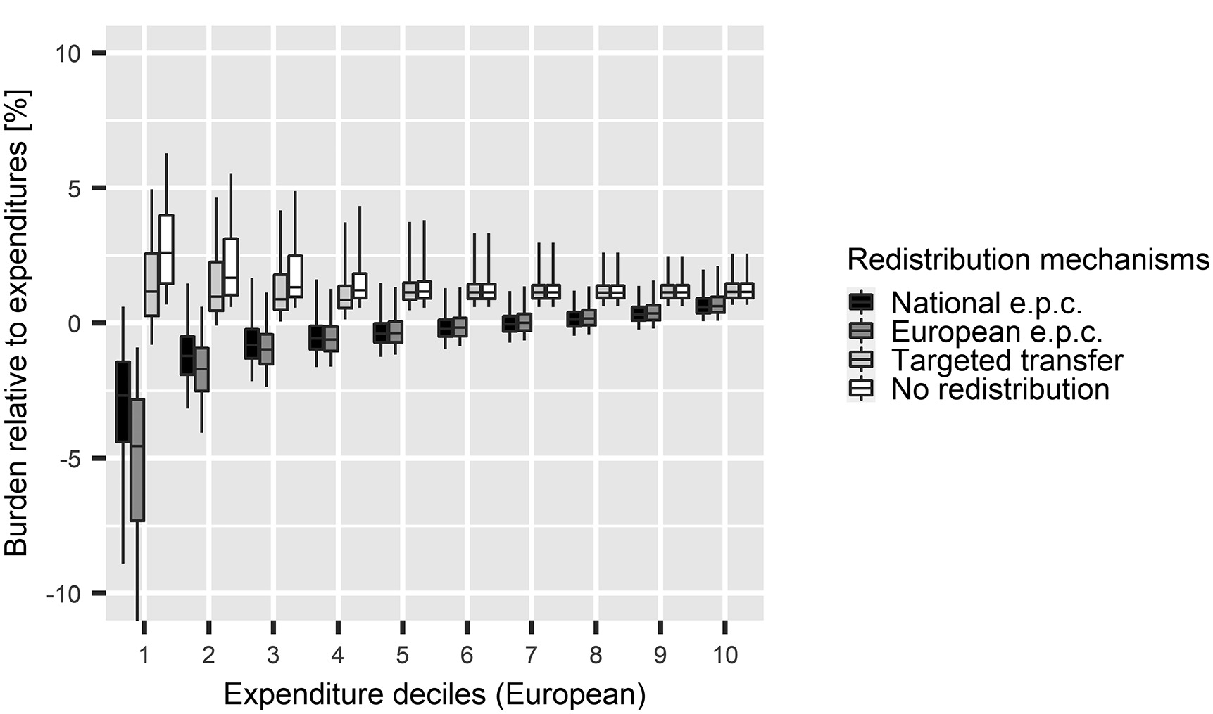
Response option #2 (political risk): National Compensation schemes
Carefully designed revenue recycling schemes scaling with carbon price enable managing net distributional impacts
Range of options: lump-sum per capita, differentiating by heating system/travel/emissions/income...
Tradeoff: Differentiation tends to enhance targeting but increases informational and administrative requirements
→ Develop & communicate domestic Social Climate Plans and provide analytical support – in time for 2027
Impact of different revenue recycling schemes for EU households
at 25€/tCO₂ economy-wide carbon price
poorest
richest
Feindt et al. 2021

Slide 15
Main message
With the introduction of the EU ETS2 as part of the Fit-for-55 package, the EU has set up a comprehensive and ambitious climate policy architecture.
Two key challenges over the next years:
Ensuring the political survival and environmental integrity of this architecture
Making sure carbon pricing contributes to effectively shifting investments
Two complementary policy options appear particularly promising:
Introduce price collars in the EU ETS1 & 2 (to address both political & investment challenges)
Carefully designed compensatory measures in Social Climate Plans (to partly address political challenge)
Flis 2023
EU Council 2023

Slide 16
Managing allowance price risk in the new EU emissions trading architecture
Prof. Christian Flachsland
14th CEPR/EAERE Webinar Series on Climate Policy
15 November
Notes:
https://www.cuddlynest.com/blog/tiergarten-charlottenburg-berlin-guide/

Slide 17
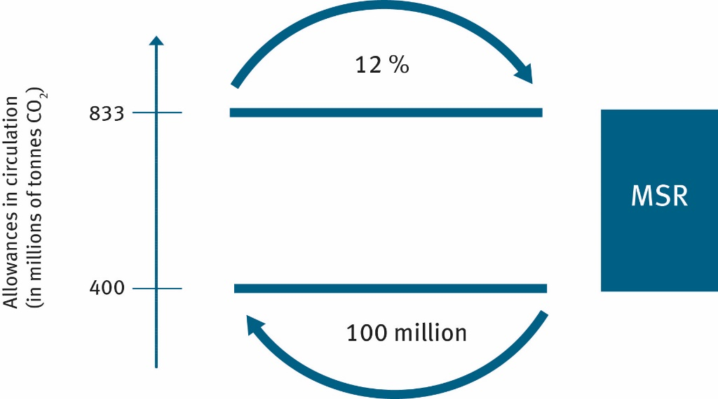
Recap: How does the MSR work?
24% (of TNAC)
(12% after 2023)
Delete allowances in MSR exceeding auctioned volume in previous year from 2023 (~57% of the annual cap, declining ~30mio p.a.)
→ Endogenous cap adjustment
Total number of allowances in circulation (TNAC) =
allowances issued minus verified emissions
Notes:
Backloading:
The auction volume is reduced by
400 million allowances in 2014
300 million in 2015
200 million in 2016.
Anm. MS: ich würde das durchgestrichene rote streichen - angenommen
Originally to be re-introduced 2019 and 2020
Genaue Definition: unallocated allowances – wo kommen die her?
Solidarity – wie läuft das genau?
Wie viel sind 12%?

Slide 18
How does the MSR work?
24% (of TNAC)
(12% 24% after 2023)
1096
In this range, remove absolute
difference between TNAC and 833mio
Delete allowances in MSR exceeding 400mio
auctioned volume in previous year from 2023 (~57% of the annual cap, declining ~30mio p.a.)
→ Endogenous cap adjustment
Total number of allowances in circulation (TNAC) =
allowances issued minus verified emissions
Notes:
Backloading:
The auction volume is reduced by
400 million allowances in 2014
300 million in 2015
200 million in 2016.
Anm. MS: ich würde das durchgestrichene rote streichen - angenommen
Originally to be re-introduced 2019 and 2020
Genaue Definition: unallocated allowances – wo kommen die her?
Solidarity – wie läuft das genau?
Wie viel sind 12%?

Slide 19
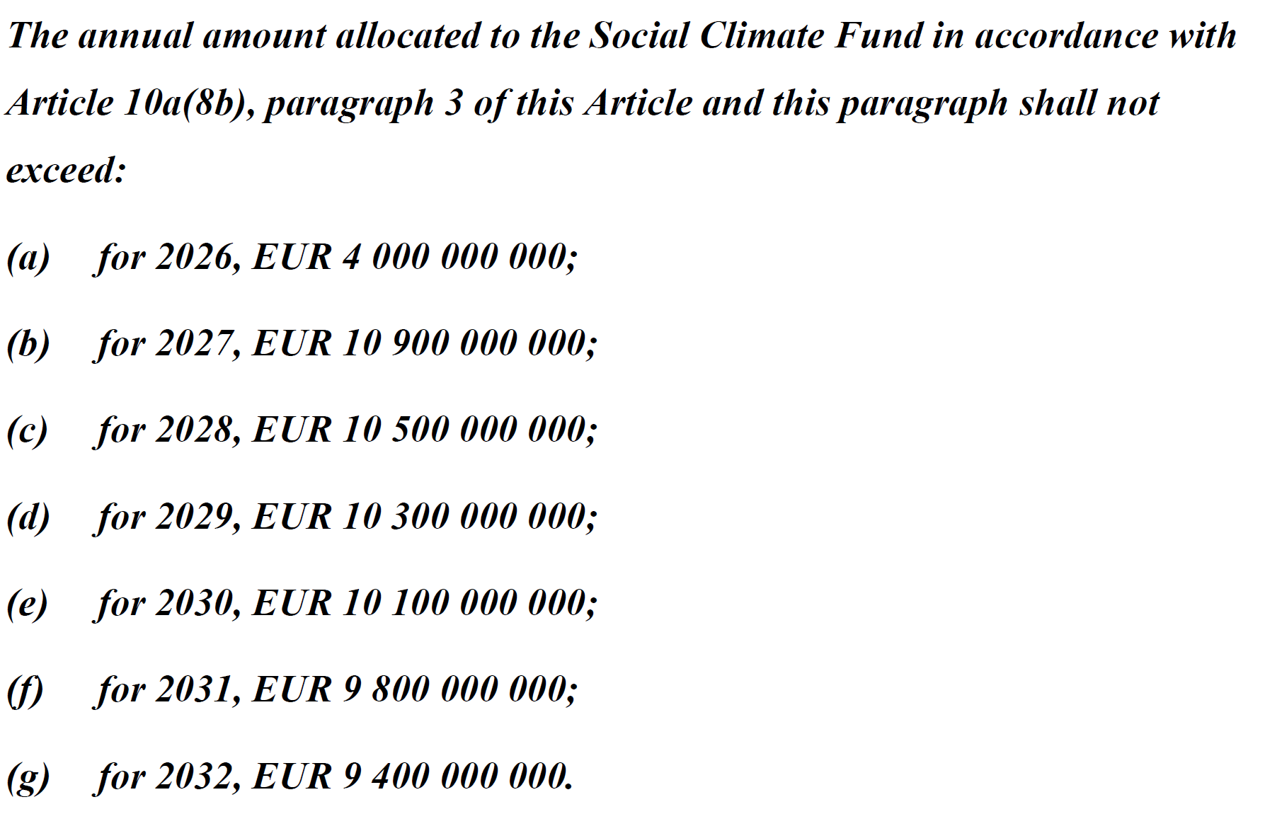
Social Climate Fund: financial volume & sources
Volume
Maximum total volume of €65bn until 2032
Finance sources
50mio ETS-1 certificates in 2025
  To create initial liquidity
Revenues from auctioning 150mio allowances (until 2031) from ETS-2
  plus additional auctioning volumes from MS allocation if revenues insufficient to meet financing goals
Scheduled to start 2026
1 year prior to ETS-2 start to increase acceptance
[detailed adjustment rules in case of
ETS-2 delay until 2028]

Slide 20
Social Climate Fund: Spending rules
Spending rules (Pause et al. 2023)
Very specific EU rule-set
Direct income support households only temporary, and max. 37,5% of MS revenue
Focus on green spending
Main categories:
  Decarbonisation of heating/cooling or reduction of energy needs of buildings, as well as financial support for low-income households in worst-performing buildings;
  uptake of zero-emission vehicles or refuelling and recharging infrastructure or public forms of transport, or financial support for low and middle-income transport users;
  finance national Social Climate Plans

Slide 21
Can the SCF insure against political risk?
Concern I: compensation does not scale with allowance price level
To protect vulnerable citizens from carbon pricing impacts, the measures to protect them need to (automatically, quickly) scale with the carbon price level
Concern II: Green spending rules may not align with social dimension
EU rules for SCF seem to overprioritize green over social measures
Synergetic measures are great, but unclear if sufficient to protect vulnerable consumers and stabilize system against political shock
→ Major concern: EU not well-prepared for potential ETS-2 price shock

Slide 22
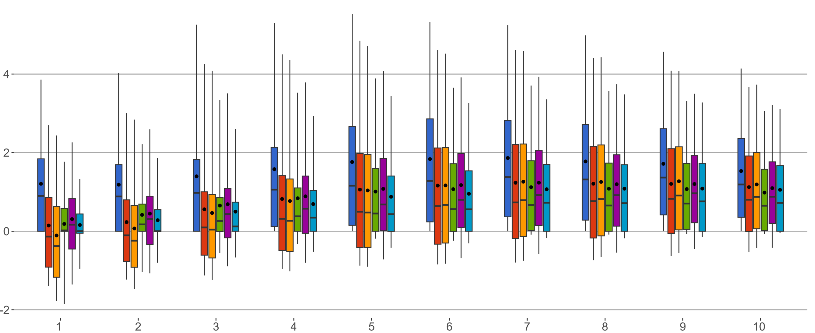
Response option #2 (political risk): National Compensation schemes
Carefully designed revenue recycling schemes scaling with carbon price enable managing net distributional impacts
Range of options: lump-sum per capita, differentiating by heating system/travel/emissions/income...
Tradeoff: Differentiation tends to enhance targeting but increases informational and administrative requirements
→ Develop & communicate national Social Climate Plans and provide analytical support – in time for 2027
Impact of 275€/tCO₂ carbon price on heating fuels in Germany, uncompensated vs. various revenue recycling schemes
poorest
richest
Household net income deciles (weighted equivalent)
Uncompensated
Lump-sum
per capita
Lump-sum
per capita, taxed
Based on heating system
Based on emissions
„Tree-based“
Kellner et al. 2023

Slide 23
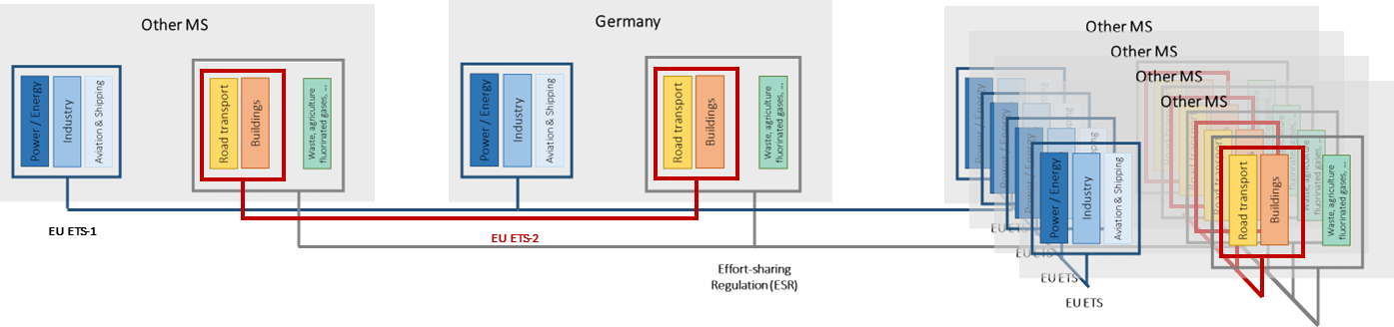
EU climate policy architecture
EU carbon pricing architecture after Fit-for-55 reform

Slide 24
@Meredith: Potential moderator questions
Why did the EU not adopt a price collar in the first place?
You talked a lot about “political risk”. Can you elaborate what you have in mind? Isn’t it hard to change/undo EU law?
As professional policy analysts, is it really our job to try to analyze political risks to carbon markets, when these are so hard to project? Shouldn’t we focus on developing and offering sound policy options?

