Slide 1
The euro at 25
Reichlin, Pisani-Ferry and Jeromin Zettlemeyer
ESM&CEPR Conference joint conference: rebuilding an agenda for Europe
Luxemburg, February 1st, 2024

Slide 2
Low inflation 2013-2020

Slide 3
ECB and Federal Reserve assets as a percentage of euro area and US GDP (Q1 of 2000 = 100)

Slide 4
1-year overnight index swap (OIS) rate shocks around ECB press conferences (in basis points)

Slide 5
Policy instruments

Slide 6
1-year overnight index swap (OIS) rate shocks around ECB press conferences (in basis points)

Slide 7
Selected sovereign spreads with the bund on 10-year benchmarks (in basis points) and key policy dates

Slide 8
Selected sovereign spreads with the bund on 10-year benchmarks (in basis points) and key policy dates

Slide 9
Tightening since July 2022

Slide 10
Tightening since July 2022 – disinflation Behind the curve again?

Slide 11
Excess reserves at the ECB deposit facilities

Slide 12
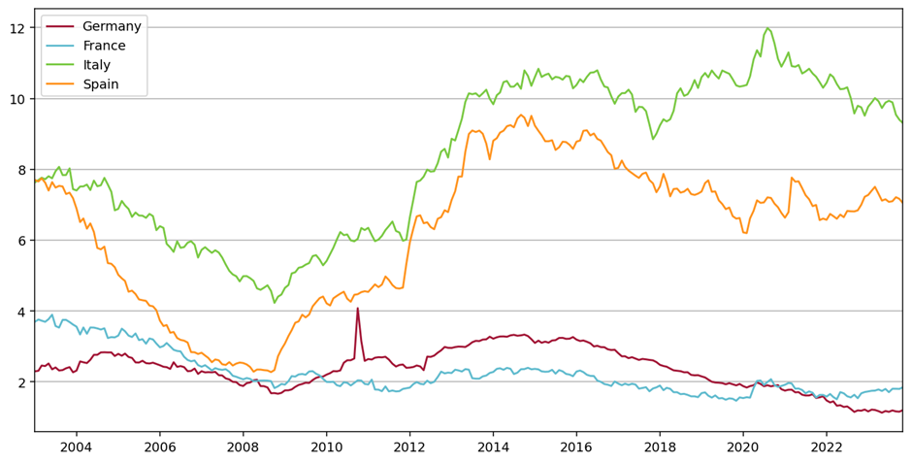
Domestic government bonds as a share of bank assets

Slide 13
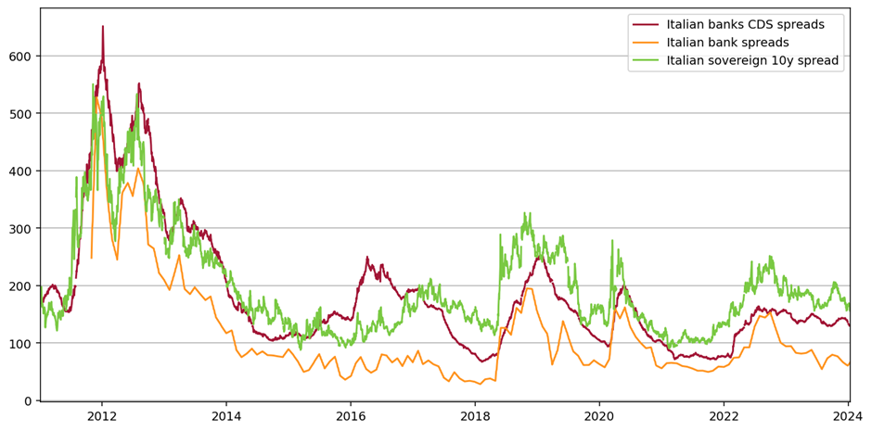
Italian sovereign and bank spreads

