Slide 1
The EU fiscal framework: Past experience and looking forward
Lilia Cavallari
Rebuilding an agenda for Europe – ESM & CEPR
Luxembourg, 1st February 2024

Slide 2
Looking back

Slide 3
Looking forward 1/2
Source: forthcoming in The reform of the EU governance framework: Illustrative scenarios for Italy, UPB Nota di lavoro 1/2024
Data from the 2023 Update of the Economic and Finance Document of Italy, Bank of Italy and Istat.

Slide 4
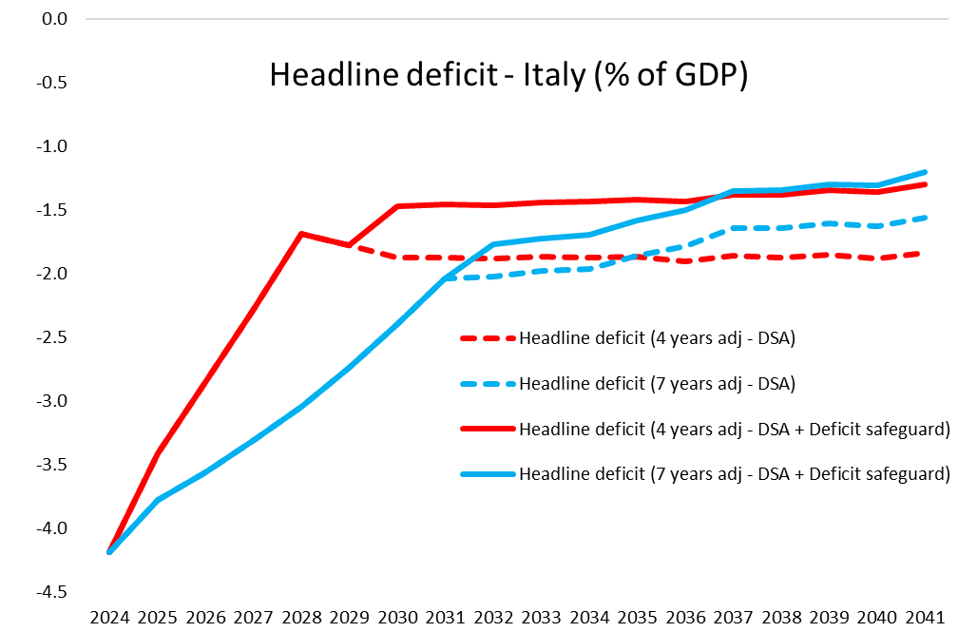
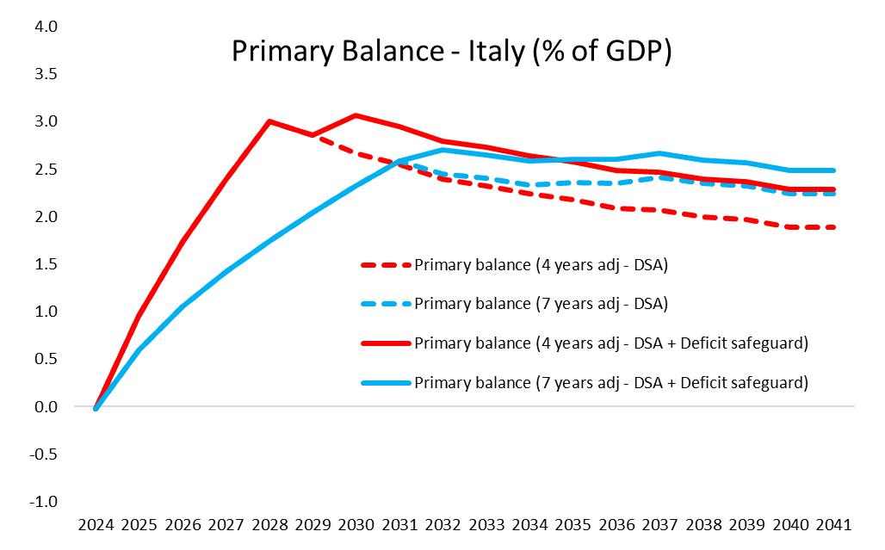
Looking forward 2/2
Source: forthcoming in The reform of the EU governance framework: Illustrative scenarios for Italy, UPB Nota di lavoro 1/2024
Data from the 2023 Update of the Economic and Finance Document of Italy, Bank of Italy and Istat.

