Slide 1
Paying for News: What Google and Meta owe News Publishers
Haaris Mateen, Anya Schiffrin, Patrick Holder and Haris Tabakovic

Slide 2
The problem: platform remuneration
The platforms and LLMs are not paying what is owed to content producers including news publishers.
In the US, the lawsuits have begun
Australia and Canada have pushed Meta and Google to negotiate
In Europe there is the transposition of the EU copyright directive
Settlements are being made around the world, many covered by Non Disclosure Agreements
Many economists believe the amounts are too small because news is valuable to Google/Meta and the Large Language Models

Slide 3
Regulation—Australia’s News Media Bargaining Code 2021
Pathbreaking in its use of competition law
Requires Google and Facebook to negotiate with publishers for the price of news
Binding arbitration if the two sides can’t reach an agreement “Baseball” or “last offer arbitration.” Differs from previous attempts because it comes from the Competition ministry and is aimed at rectifying “power imbalances”
Controversial because of worries it will support Rupert Murdoch’s empire and not help the smaller outlets. In fact, they negotiated too and got payments
After threats from Google and Facebook, Google increased payments to publishers. Law passed in late February 2021 with some modifications (2 month mediation period before going into arbitration). Google settled copyright disputes in France

Slide 4
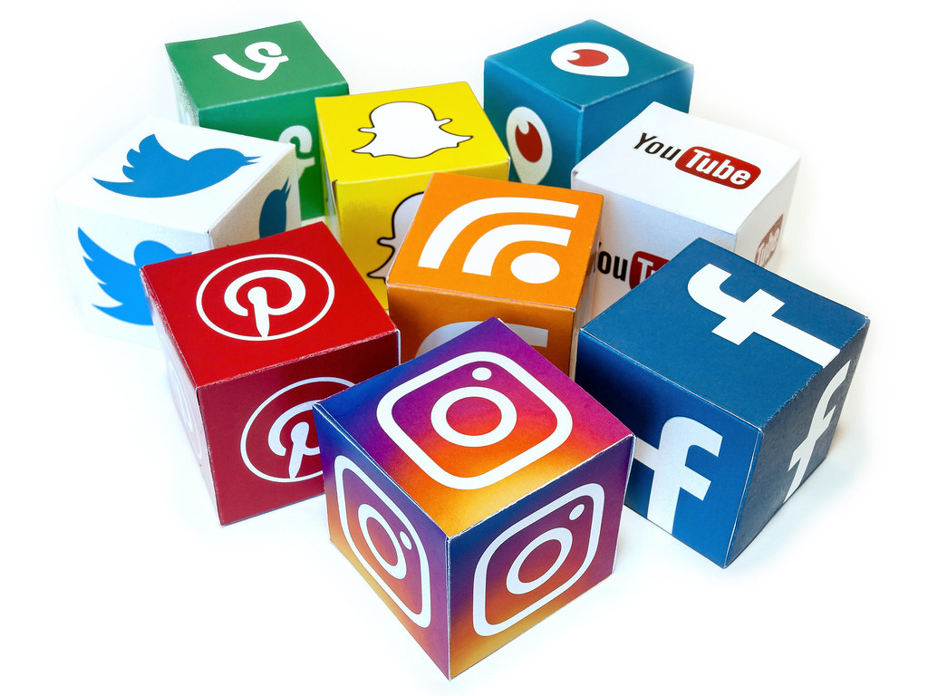
Global Principles for Platform Remuneration
In July 2023, news publishers from around the world gathered in South Africa and declared global principles for bargaining with Big Tech.
Our new global principles call on the next set of laws to improve upon Australia’s law
Transparency
Guarantees the money will go to journalism
Include small outlets as well as large ones
“Both platforms and publishers should adopt the highest possible degree of transparency so that all parties can judge the fairness of any deal and so that third parties can assess and evaluate the impact of the mechanism as a whole. For example, mechanisms may require platforms and publishers to share data about the size and behavior of their audiences and advertising placements,” section seven of the principles reads.
THE REALITY: Google is paying publishers around the world and requiring NDAs. Interviews suggest that amounts have recently increased. They spend money on lobbyists. Google and Meta say news is not essential. So why are they fighting paying fairly for it?
Notes:
https://www.poynter.org/commentary/analysis/2023/news-publishers-declare-global-principles-for-bargaining-meta-google/

Slide 5
Responses and Implications
Facebook, Google still oppose NMBC – Facebook temporarily blocked all Australian news sharing in 2021.
Since going into effect, the NMBC has allowed Australian News Producers to extract over $200 million ($150 USD) from tech companies - revenue that can fund local journalism (Grueskin, 2022)
Lack of transparency in how news producers are being compensated; concerns over information and financial asymmetries (Grueskin, 2022)
Small outlets added in later (Schiffrin 2022)
International impact: other countries (Canada, UK, Indonesia, South Africa, US) debate adopting similar regulatory frameworks (Grueskin, 2022)
The Code’s First Year of Operation
November 2022
Findings from the review:
The Code has been a success to date.
Over 30 commercial agreements between digital platforms (Google and Meta) and a cross section of Australian news businesses have been struck, agreements that were highly unlikely to have been made without the Code.
Notes:
The Treasury’s report is accessible here: https://treasury.gov.au/publication/p2022-343549

Slide 6
Hal Singer (2023) Payments in Other Jurisdictions
Australia
$134M USD or ~4.1% of Australian Google Search revenues*
4.1% for the U.S. would be $3.2 billion.
4.1% for California would be $0.5 billion.
Canada
$74M USD or ~1.7% of Canadian Google Search revenues
1.7% for the U.S. would be $1.4 billion.
1.7% for California would be $0.2 billion.
Note: These figures exclude deals made prior to the legislation and other payments in kind. Eligibility to receive funds in Canada—i.e., the pool of participants—is more narrowly defined than what is being considered in the United States. *It is unclear what percentage of the Australian payments are from Google vs Facebook. For ease of comparison, I assume all payments are made by Google.

Slide 7
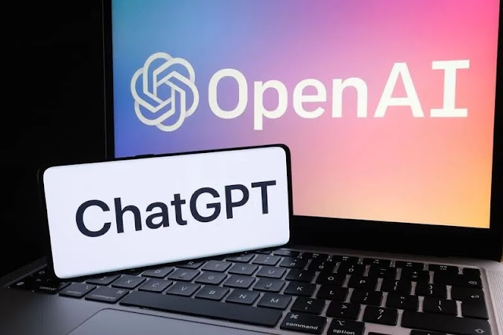
News and large language models
collective action and collective negotiation will be necessary to get a fair price.
The large companies like Open AI will need to pay for content and those deals can be negotiated collectively.
The AI companies are in an arms race and they need reliable content. They are in more of a hurry than the journalism organizations.
However, the small open source companies that will develop will steal content and it will be hard to do anything about it.
Right now there is no way to determine whether your content has been used. That is a problem.
Even a paywall does not protect news content.
Terms of Use need to bar use of content for training

Slide 8
AI’s Risk to Publishers
Opportunities for Agreements
Right now, there is no way for publishers to determine if their content has been used by the LLM
Smaller open source companies will develop are going to steal content and it will be hard to do anything about it.
Large companies like OpenAI will need to pay for content, creating an opportunity for collective negotiation with publishers.
AI companies are in an arms race for reliable content. They are in more of a hurry than journalism organizations.
Producers of reliable content in Spanish, Portuguese and other languages are in an especially good position to negotiate.
Outlets with images, video, historical archives and current content with journalists who can answer questions are all in possession of valuable content

Slide 9
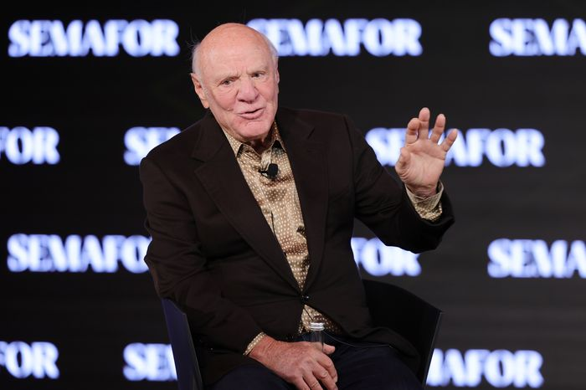
Publishers Prepare to Take on AI
Barry Diller, chairman of massive media holding company IAC, is hoping to lead publishers in legal action to protect their work from being stolen by AI companies and used in LLMs
Diller argues for an end to “FAIR USE” and changes to U.S. copyright law
He believes this litigation is the only solution, but it may encourage legislation that will help publishers deal with generative AI
Such collective action would be an opportunity for smaller outlets to join a larger, more powerful group and gain protections
Reality: separate deals being made
“You have to narrow the copyright law to say that no engine, no LLM, no generative AI system can infringe upon your ownership of what you create and publish…the result that will come out of that is enough economic activity for publishers to support them…I think if it doesn’t happen, it’s a disaster.”
Diller in an August interview for “On with Kara Swisher”

Slide 12
Key findings from the paper
Using game theoretical insights into cooperative bargaining in cases where value is jointly created, we find a compelling case for a large payment from platforms to news publishers.
Facebook owes US$1.9 billion to US publishers annually for use of their content on its platform.
Google owes US$10–12 billion to US publishers.
Using existing platform-publisher agreements around the world as a benchmark, we find that a fair revenue split would give news publishers 50% of news-related revenue earned by Google and Facebook.
We document that Google and Facebook are making payments to publishers around the world that are vastly below our estimates of a “fair payment”.

Slide 13
Fundamental question: what is the surplus value generated by platforms-publishers?
Platforms and publishers jointly create additional value. This is what needs to be shared fairly
For the digital platforms, news media provides a source of high-quality content to keep their users engaged and coming back to the platforms.
Likewise, for news publishers, the platforms provide popular, easy-to-use channels through which to distribute news content to a larger audience.
But market power of platforms means they underpay

Slide 15
News consumption on digital platforms—search is stable

Slide 16
Importance of Impressions to revenues of Google and Facebook
“User impressions” is a metric used to quantify the number of times a user views a website where an advertisement is displayed.
It measures user engagement with the content on their screen and increases the chance that users will view and notice advertisements.
Crucially, there are feedback effects and network effects.
Click-through is downstream

Slide 17
News is Valuable to google
News content allows Google to provide better, more current, and more reliable search results, increasing likelihood it’ll be used for ANY internet search in the future.
In other words, news content contributes to the attractiveness of Google overall, and increases its value, credibility and completeness.
Amplified via network effect : by attracting more users, the platform attracts more paying advertisers to join.
Also, the more people use the search, the more data Google collects.
Allows to improve both its search engine and results, and ad reach/targeting.
Better search results enhance user experience and improve outcomes for advertisers
Google increases the overall value of its search engine on multiple sides of the platform.

Slide 18
Three components of our methodology
Calculate relevant advertising revenue for platform
Calculate share of advertising revenue attributed to presence of news content
Find the appropriate split-share between platform-publisher
Data from company filings
Use state-of-the-art studies
Historical benchmarks;
Economic theory

Slide 19
Methodology for calculating Google payment
How many people use Google because it provides them information, and how many people would stop using Google if it did not have information?
How much of the information content comes from news?
Roughly 35% of all demand for Google searches is from users seeking news content (we base this on the Fehr AG RCT)
About 10 billion dollars each year (in the US)

Slide 20
Methodology for Facebook
What is the share of time users spend consuming news on Facebook?
Depend on data that measures usage patterns
About 13% of time spent consuming news (we based this number on the data available in the Alcott et al 2020 AER paper on Facebook use “The Welfare Effects of Social Media”)
About 2 billion dollars (each year)

Slide 21
Our FB methodology: you can try it too

Slide 22
Google Methodology: you can do it too

Slide 23
Existing deals are far from 50/50, except Australia

Slide 24
Questions
What about the subscription revenue already received? Where does that fit in?
Offset payment owed by platforms against 50% of revenues earned from click-through
What if platforms reduce news content?
Substitution patterns
Market importance
Duration of reduction
Deals being signed; just opaquely
What about AI? How do we calculate what news is worth to LLM?
Even stronger case for payments to be made for any LLM results related to current affairs
But also payments needed for legacy information generated by news

Slide 25
Conclusion: transparency of methodology
Conclusion is robust to change in assumptions. The methodology is there to be used/tweaked.
In almost any scenario, the numbers dwarf current payments made. Publishers are getting far less than our findings.
We want to make the discussion more transparent --- our method is replicable and flexible.
A law would require disclosure of data to pin down numbers more concretely. Please share any data you want with us.

Slide 26
Thanks!
Haaris Mateen: hm2692@columbia.edu

