Slide 1
The extent of the market for early American bank notes
Rutgers – Money, History and Finance workshop
October 2023

Slide 2
How far did antebellum bank notes travel?
Accounts from the time suggest not very far.
In Boston, “a Boston bank note passes in all commercial transactions the same as coin, [but a] Philadelphia bank note does not pass in Boston.” – Richard Hildreth (1840)
“Started from Virginia with Virginia money – reached the Ohio River – exchanged $20 Virginia note for shin-plasters and a $3 note of the Bank of West Union – paid away the $3 note for breakfast – reached Tennessee – received a $100 Tennessee note – went bank to Kentucky – forced to exchange the Tennessee note for $88 of Kentucky money. – William Lowndes to John C. Calhoun

Slide 3
Motivation
Q1: How widely will private currencies be used when verification and transactions costs are substantial?
In an historical context, monetization facilitates impersonal trade.
Trade facilitates specialization and division of labor.
Specialization and division of labor leads to Smithian growth, which is a precursor for modernization.
Cagan (1963) doubted whether US would have experienced late-nineteenth century growth if economy relied on private currencies.

Slide 4
Motivation 2
Understanding how and how far bank notes traveled as a first step toward constructing a more historically accurate characterization of antebellum bank note markets than is current in the literature. How is the current approach inadequate?
  Gorton’s (1996) and Jaremski’s (2011) studies may generate incorrect inferences because:
  (1) its use of travel times or costs do not account for trade networks and trade flows;
  (2) it fails to account for some fundamentally important institutional features; and,
  (3) it is unlikely that reported discounts are transaction prices; without market-based price discovery how do we value assets that are rarely, perhaps never, traded?

Slide 5
Quick preview
Why did the public tolerate, even embrace, a currency that depreciated as it moved away from its point of issue?
  Encountering a note issued by a bank 50 miles away was a coin flip; the average discount of a 50-mile note was 0.67% and the median discount was zero.
  Individuals encountered notes that were issued close to where they lived, with which they were familiar, and for which verification costs were small.
  Notes used in daily transactions satisfied Gorton’s “no questions asked” criterion.

Slide 6
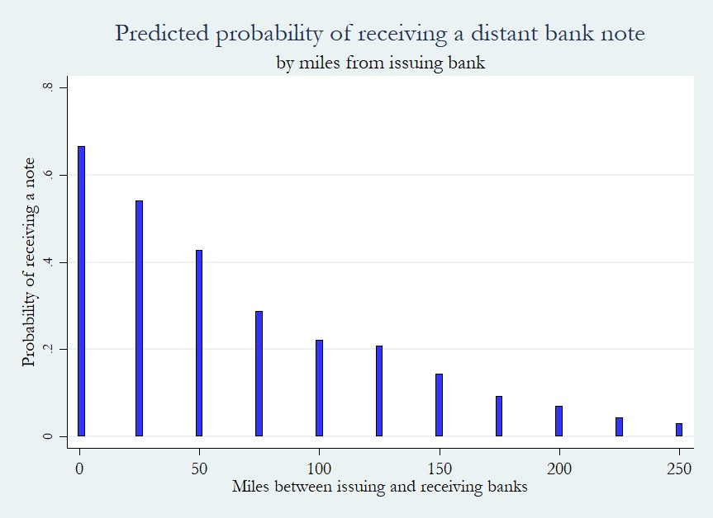
Preview of main result

Slide 7
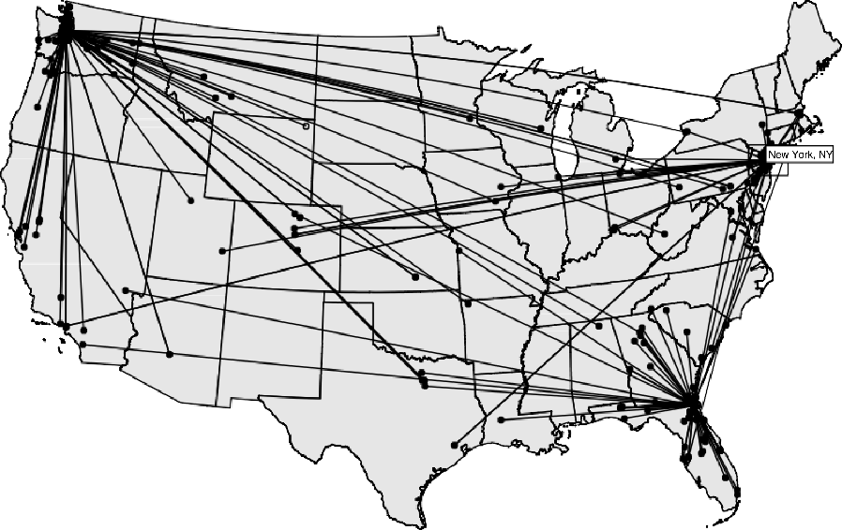
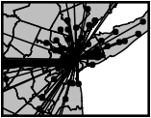
How far do modern Federal Reserve notes travel?
Dispersal of notes follows an inverse power law distribution:
P(d) ~ d^{-(1+β)}
β = 0.59 +/- 0.02
Probability decays rapidly in distance
Brockman and Hufnagel (2007).

Slide 8
Market for bank notes
Privately-issued bank notes were small-denomination, non-interest-bearing, risky, perpetual debt obligations of the issuing banks.
Banks were required to redeem notes into legal tender at par on demand or face revocation of their charters.
Note holders faced potential losses, but monitoring was uneconomic for holder of a few dollars worth of notes.
Several public and private monitoring and redemption systems developed, the most interesting of which were note brokers, who made markets in distant (uncurrent) notes by buying them at a discount from face value and redeeming them at par.

Slide 11
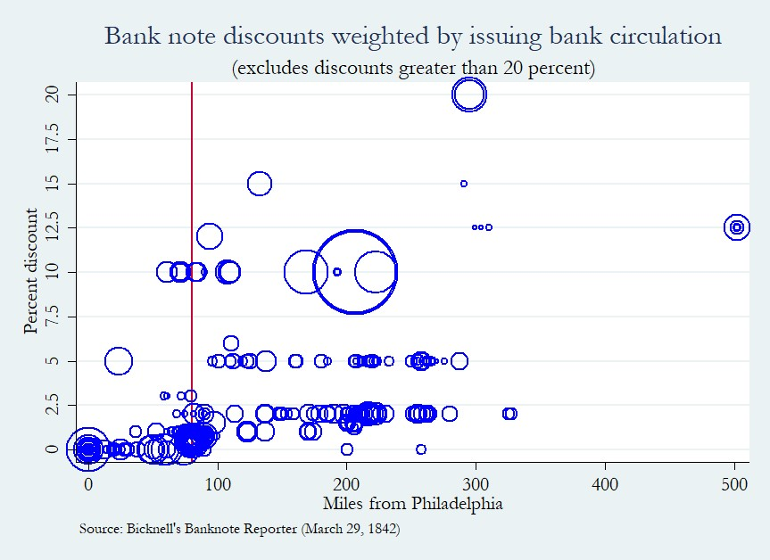

Slide 12
Modeling the market for bank notes
Gorton (1996) derives a Black-Scholes option pricing formula for notes.
Implications:
  Price of notes varies inversely with distance to issuing bank and leverage. But, due to differences in leverage, not all notes issued by banks an equal distance away from a given location will circulate in that location.
  No-arbitrage condition implies that notes issued by all banks at a given location will sell for the same price.
  At least some distant goods are preferred to home goods due to geographic specialization. Utility-maximizing consumers facing a cash-in-advance constraint have an optimal distance from home that they will travel to purchase goods.
  There is a critical distance beyond which a bank’s notes will not serves as a medium of exchange.

Slide 13
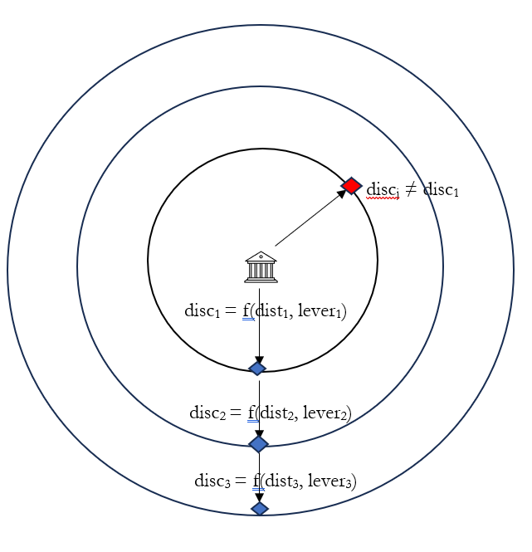
Gorton (1996) model and Gorton, Ross, and Ross (2022) estimates
Critical “distance”
d_{max} = 23.3 days
Challenge to translate 23 days into actual DISTANCE given available transportation technologies – walking, horseback, stagecoach, canal, train.

Slide 14
Trade flows, finance, and bank note flows
Eastbound goods on waterways were mostly primary products (wheat, livestock) or processed primary products (flour, lumber, bacon).
Westbound goods were manufactured goods, mostly wholesale consumer goods and machinery.
Neither of these flows were facilitated nor financed with bank notes.
Commission merchants in the west purchased primary products on credit using bills of exchange payable in urban markets or by drawing on accounts held in other banks. Western merchants bought on credit from urban wholesalers, drawing on accounts at their home banks.
Bank notes tended to move short distances in small amounts in travelers’ pockets.

Slide 15
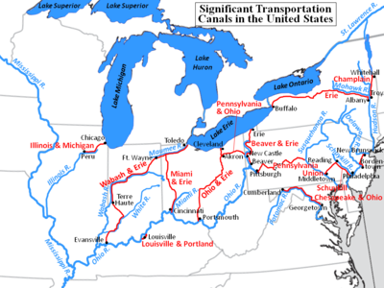
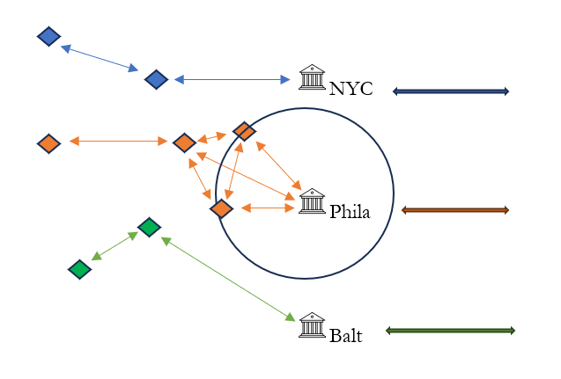
Trade flow modified Gorton model

Slide 16
Data: Pennsylvania Auditor General (1842, 1849)
On March 16, 1842 Philadelphia’s banks jointly refused to accept the notes of the Bank of Penn Township, located in Philadelphia County, but outside the city limits.
Refusal ignited a short-lived bank run that started with Penn Township and spread to all city banks. Two days later the banks coordinated limited resumption and runs subsided.
Legislature asked Auditor General to solicit detailed balance sheets as of March 2, 1842 – two weeks prior to the run. In addition to balance sheets, they asked for details of holdings of other banks’ notes and interbank balances.
37 (of 42) banks responded but only 17 banks provided detailed note holdings and interbank balances. Reasonably representative sample.

Slide 17
Data – interbank balances of Easton Bank (Penn Auditor 1842)
Due from other banks
Due to other banks

Slide 18
Data 2 – notes of other banks

Slide 19
Data
In addition to interbank balances and notes of other banks, the data include balance sheet information:
Assets = loans, specie reserves, amounts due from other banks
Liabilities = notes in circulation, deposits, due to other banks, capital, retained earnings
Initial review of notes of other banks show that few notes beyond the six states contiguous to Pennsylvania – New York, New Jersey, Delaware, Maryland, Virginia, and Ohio – so analysis is limited to these states

Slide 20
Table 2
Summary statistics for 17-bank sample
 | (1) | (2) | (3) | (4) | (5) | (6)
VARIABLES | mean | sd | mean | sd | mean | sd
 | Full sample |  | Philadelphia only |  | Country banks
Circulation ($) | 151,291 | 273,482 | 142,610 | 255,161 | 152,002 | 274,845
Bank notes held ($) | 86.50 | 878.9 | 150.8 | 1,376 | 47.29 | 337.8
Due to bank ($) | 105.0 | 1,361 | 251.6 | 2,227 | 19.50 | 183.3
Due from bank ($) | 99.65 | 1,216 | 124.7 | 1,620 | 81.23 | 876.5
Counterfeits (#) | 4.033 | 7.208 | 3.764 | 6.927 | 4.031 | 7.200
Miles | 166.9 | 98.49 | 165.7 | 112.8 | 175.5 | 97.18
ln(circulation) | 11.41 | 0.971 | 11.35 | 0.991 | 11.41 | 0.976
ln(Due to bank) | 0.259 | 1.302 | 0.417 | 1.700 | 0.166 | 0.986
ln(Due from bank) | 0.277 | 1.341 | 0.347 | 1.480 | 0.226 | 1.225
Bank age (yrs) | 16.46 | 12.54 | 15.61 | 12.22 | 16.55 | 12.54
Susquehanna River (0/1) | 0.0289 | 0.167 | 0.0276 | 0.164 | 0.0297 | 0.170
Delaware Hudson Canal | 0.0136 | 0.116 | 0.0118 | 0.108 | 0.0136 | 0.116
Lehigh Delaware Canal | 0.0785 | 0.269 | 0.0709 | 0.257 | 0.0814 | 0.274
Main Line Canal | 0.0534 | 0.225 | 0.0512 | 0.221 | 0.0551 | 0.228
Morris Canal | 0.0211 | 0.144 | 0.0165 | 0.128 | 0.0221 | 0.147
Number of banks | 17 |  | 5 |  | 12
Observations | 3463 |  | 1269 |  | 2356

Slide 21
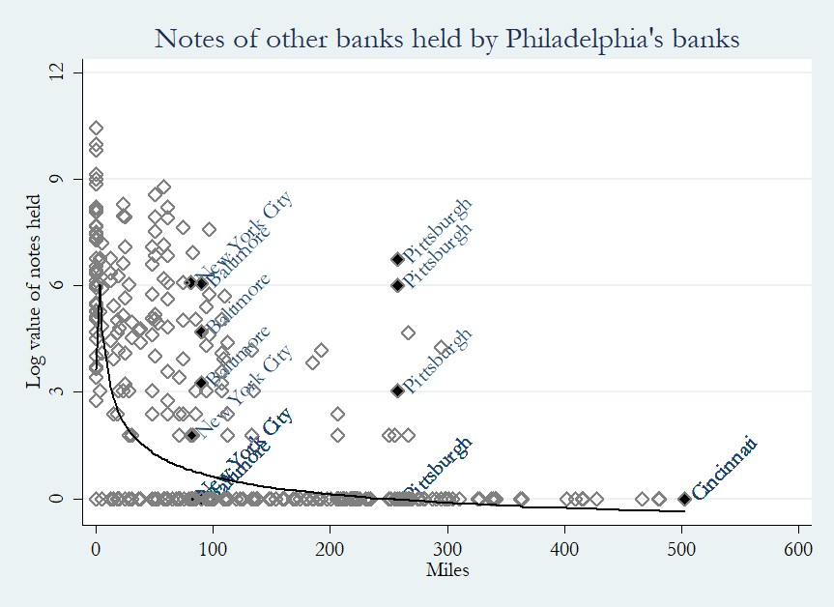

Slide 22
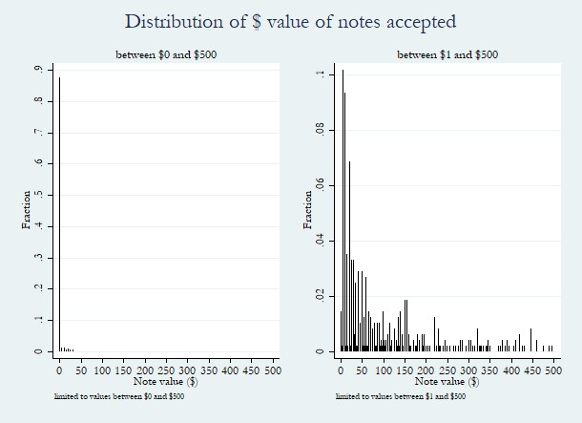

Slide 23
Empirical approach
Dependent variable is non-negative integer count data: $0, 1, 2, 3, 4, …, 101, …
Excess zeroes suggests a data-generating process with count data and a binary random variable with a probability mass at zero.
Mass at zero may be strategic or structural (incidental):
  Structural or incidental = zero is a natural outcome in that some distant notes are not observed because they do not travel a given distance
  Strategic = zero is observed because a bank may have been presented with a note issued by a distant bank, but refused to accept it because remittance costs made acceptance unprofitable or it was a suspected counterfeit, or whatever other reason.
Zero-inflated negative binomial regressions allow us to model excess zeroes separately as a logistic process and the entire distribution follows Poisson.
Comparable to a Heckman selection model, without the exclusion restriction requirement.

Slide 24
Table 3
Determinants of dollar value of other banks' notes held
 | (1) | (3) | (4) | (6) | (7)
VARIABLES | Tobit | Poisson | NB | ZINB | Logistic
Miles | -41.8461*** | 0.9686*** | 0.9040*** | 0.9598*** | 1.0108***
 | (12.6649) | (0.0080) | (0.0120) | (0.0070) | (0.0012)
Miles squared | 0.1795*** | 1.0000 | 1.0004*** | 1.0002***
 | (0.0649) | (0.0001) | (0.0001) | (0.0001)
Mules cubed | -0.0003** | 1.0000 | 1.0000*** | 1.0000***
 | (0.0001) | (0.0000) | (0.0000) | (0.0000)
ln(Circulation) | 636.9052*** | 1.6731*** | 2.4429*** | 1.7165*** | 0.5872***
 | (161.2047) | (0.2117) | (0.2709) | (0.1149) | (0.0718)
ln(Due to bank) | 162.1009*** | 1.1837*** | 1.5675*** | 1.1510*** | 0.7812***
 | (33.3291) | (0.0463) | (0.0849) | (0.0342) | (0.0309)
ln(Due from bank) | 199.6073*** | 1.2752*** | 1.4627*** | 1.1546*** | 0.8236***
 | (67.0274) | (0.0849) | (0.1536) | (0.0393) | (0.0299)
Counterfeits | -56.6893** | 0.9586 | 0.9761 |  | 1.0923**
 | (28.8497) | (0.0356) | (0.0148) |  | (0.0472)
Bank age | 12.2656 | 0.9813 | 1.0205 |  | 0.9732**
 | (10.4367) | (0.0163) | (0.0139) |  | (0.0130)
Bank note discount | -15.5765 | 1.1044 | 1.2926* | 1.1413** | 1.1324
 | (111.7468) | (0.1929) | (0.1771) | (0.0740) | (0.1687)
Susquehanna River | 681.9797 | 1.4463 | 10.7289** |  | 0.2602*
 | (521.4427) | (0.8598) | (10.9239) |  | (0.1790)
Delaware-Hudson Canal | 1,074.9202 | 0.0502*** | 3.5624 |  | 0.3303
 | (777.1309) | (0.0242) | (3.0098) |  | (0.2790)
Lehigh-Delaware Canal | 1,081.4822*** | 1.7384* | 5.4757*** |  | 0.3342***
 | (398.1243) | (0.5805) | (2.6227) |  | (0.1160)
Main Line Canal | 1,172.6394*** | 1.2312 | 29.6973*** |  | 0.2024***
 | (439.6047) | (0.5183) | (23.9688) |  | (0.0829)
Morris Canal | -472.1331 | 1.0574 | 0.1727** |  | 1.5245
 | (481.1431) | (0.3635) | (0.1438) |  | (0.9239)

Slide 25
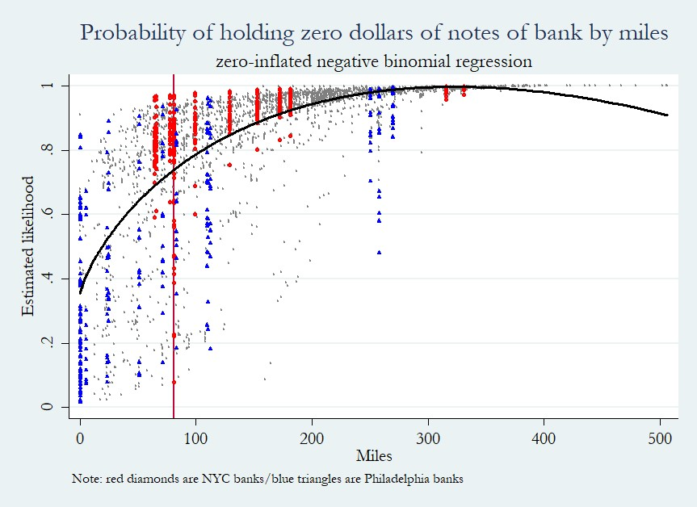

Slide 26
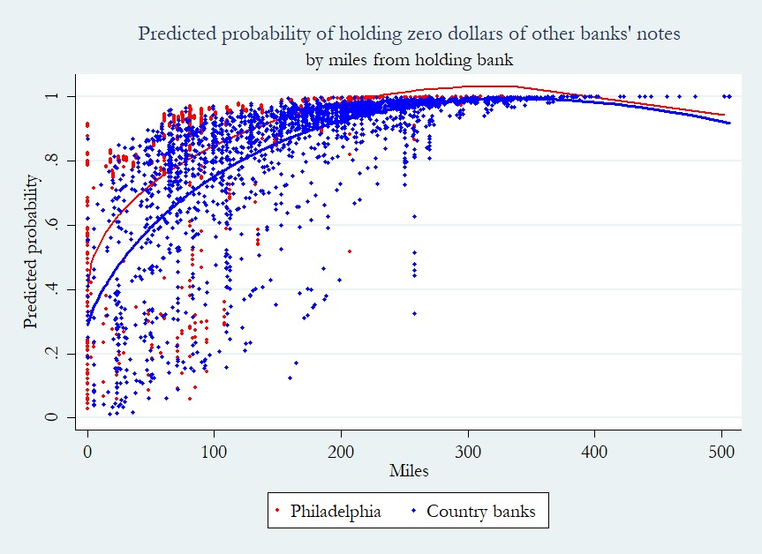

Slide 27
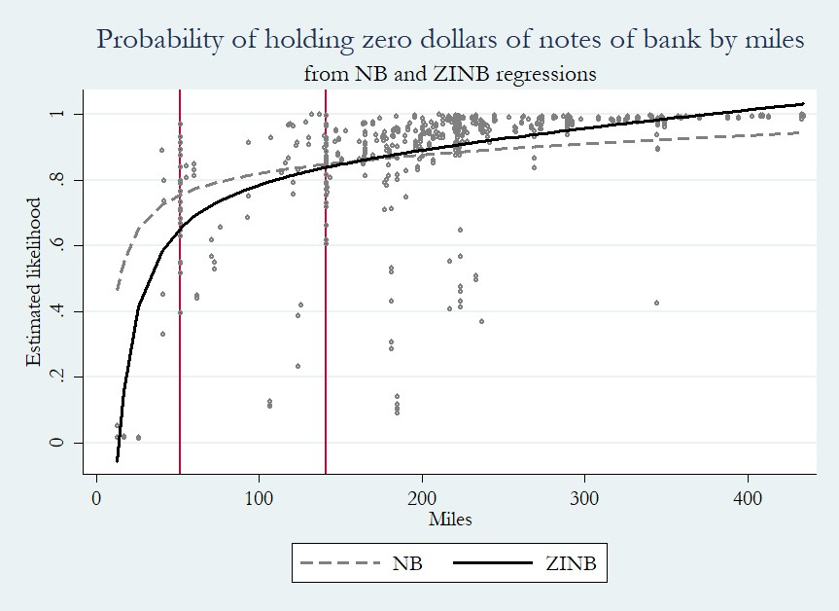
Columbia Bank & Bridge Company (1849)

Slide 28
Summary takeaway from 1842 and 1849 reports
Question: Why did the public tolerate a currency that depreciated as it moved away from its point of issue?
There was a small likelihood that the public (< bank probability, surely) encountered distant notes on daily basis.
Verification costs were low:
The average discount of a 50-mile note was 0.67%; median discount was 0.0%.
Average number of counterfeits was 3.7, median was 1.0.
Average number of small denomination counterfeits was 2.3, median was 0.0.
Notes issue 50 miles away or less satisfied the “no questions asked” criterion.

Slide 29
Discussion
Issue 1: Strategic refusals versus structural low likelihood of encounters
State Bank of Indiana branches reported on note acceptance practices prior to 1837.
All branches reported that they stood ready to accept notes from Ohio, Kentucky, Virginia, Pennsylvania, New York State, New York City, Boston, and New Orleans.
Most refused to accept notes of the State Bank of Illinois, which was not well regarded.
Reports of notes accepted were issued relatively close or by banks along the Ohio River
Points of issue included: Indiana, Kentucky, Cincinnati, Pittsburgh, New Orleans, Wheeling, and $25 from South Carolina.

Slide 30
Discussion
Issue 2: Divest of distant notes quickly so they do not appear in the data
Some Indiana branches, especially those along the Ohio River, remitted notes to note brokers in Cincinnati once they had a few hundred dollars worth on hand.
Other branches accumulated substantial sums prior to redemption. Richmond branch had as much as $12,510 before sending to Cincinnati broker.
New Albany branch had $12,740 of Union Bank of New Orleans notes and had to negotiate redemption plan.
Branches on Ohio River held modest balances of other Ohio River-banks to accommodate merchants and travelers.

Slide 31
Discussion
Issue 2: Divest of distant notes quickly so they do not appear in the data
New York State (1842) required all country banks to nominate a redemption agent in either New York City or Albany.
Country banks maintained interbank balances with redemption agents sufficient to meet average monthly redemptions.
Most agreed to return redeemed notes and request replenishment of accounts every 13 to 30 days.
Redemption agents were compensated by accepting notes at small discount (0.5%) or by charging country banks interest on average monthly note balance.

Slide 32
Discussion
Issue 3: Geographic distribution of banks’ acceptances differed from that of banknote brokers purchases.
Records of Samuel B. Gorham, small-time note broker located in Darien, CT circa 1850.
Accepted (presumably discounted) 483 notes tendered by 192 individuals issued by 85 banks located in 54 cities and towns.
Average (straight-line) distance to point of issue was 107.1 miles, median 70.4 miles.
More notes from NYC than elsewhere.

Slide 33
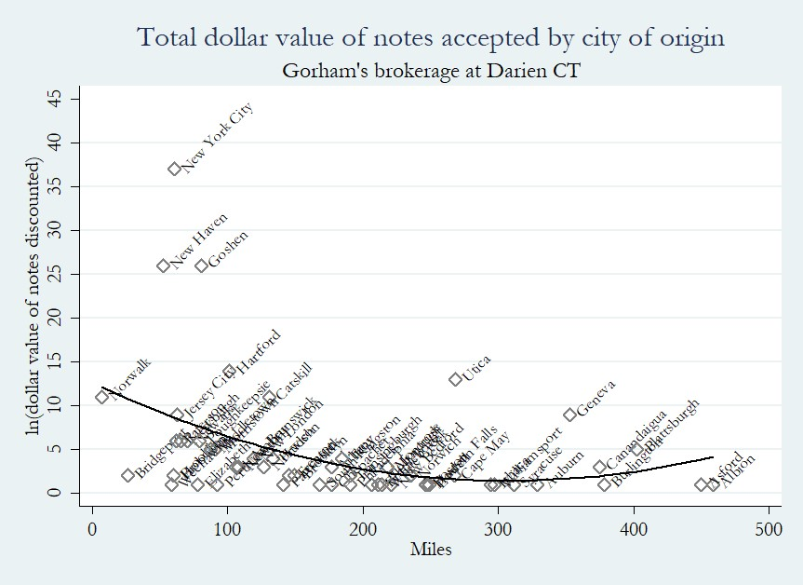

Slide 34
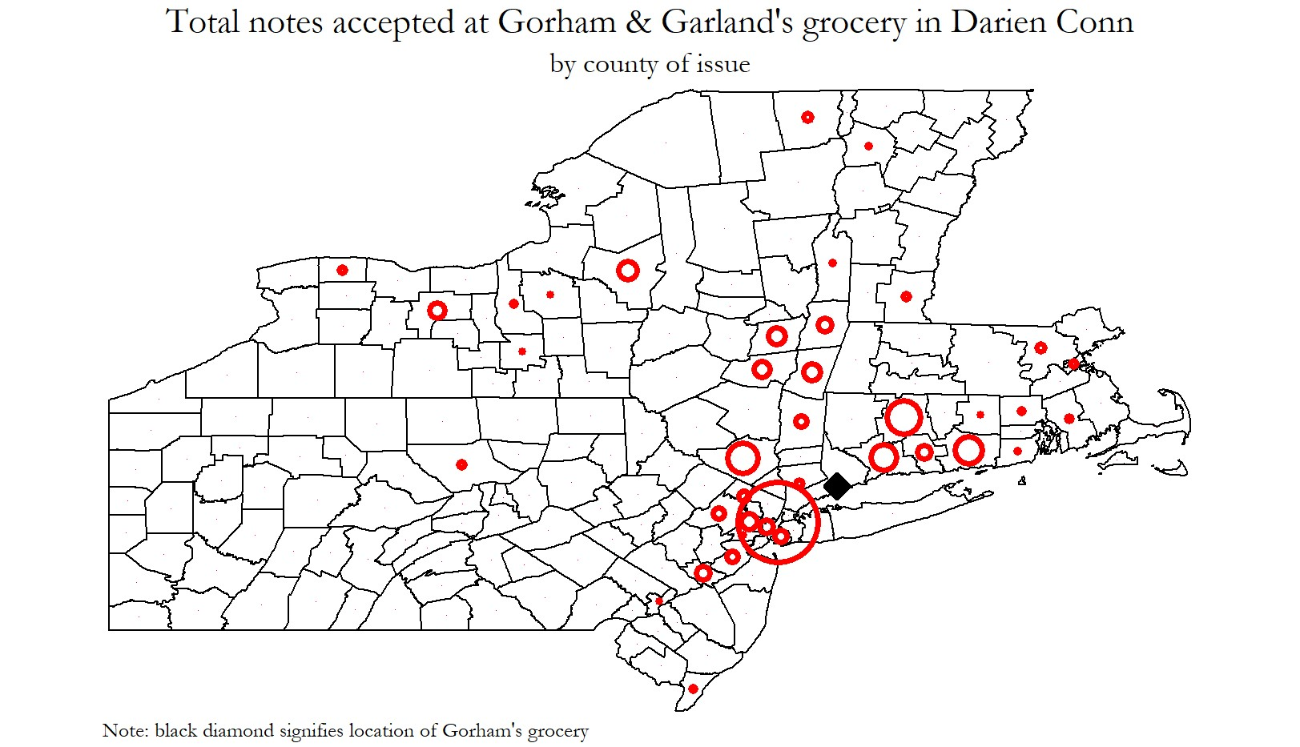

Slide 35
Conclusion
How far did bank notes travel?
There was a small likelihood that the public regularly encountered notes from as far away as 50 miles.
Within that radius, verification costs were low, and most notes satisfied the “no questions asked” criterion.
Noes did not radiate outwards from their issuing bank across a featureless plain.
Rather, notes moved in small amounts with traders and travelers along well traveled trade routes.
Contra Cagan, pro Rockoff and King, private currencies did not impose substantial costs on the public nor impede impersonal exchange.

